Slide 1
Performance Portfolio

Slide 2
Tips on How to Create a Portfolio
Include a description for each document ( your caption can contain title, date, produced, context, purpose and evaluation)
Include dividers so it is easy to find documents dividers
Sell yourself ( MOV’s)

Slide 3
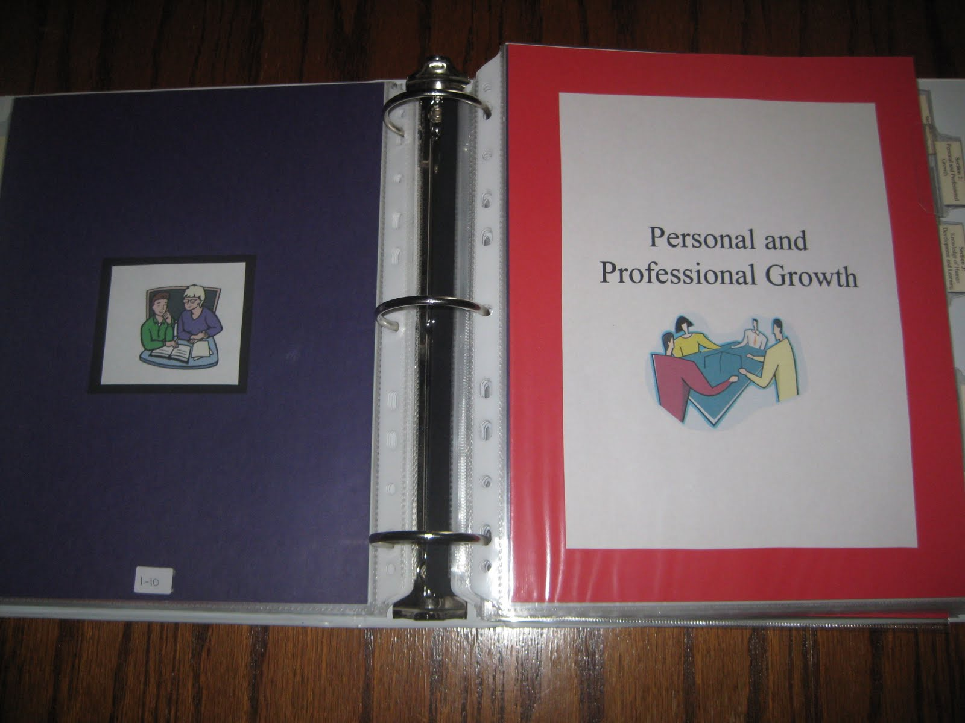
sample

Slide 4
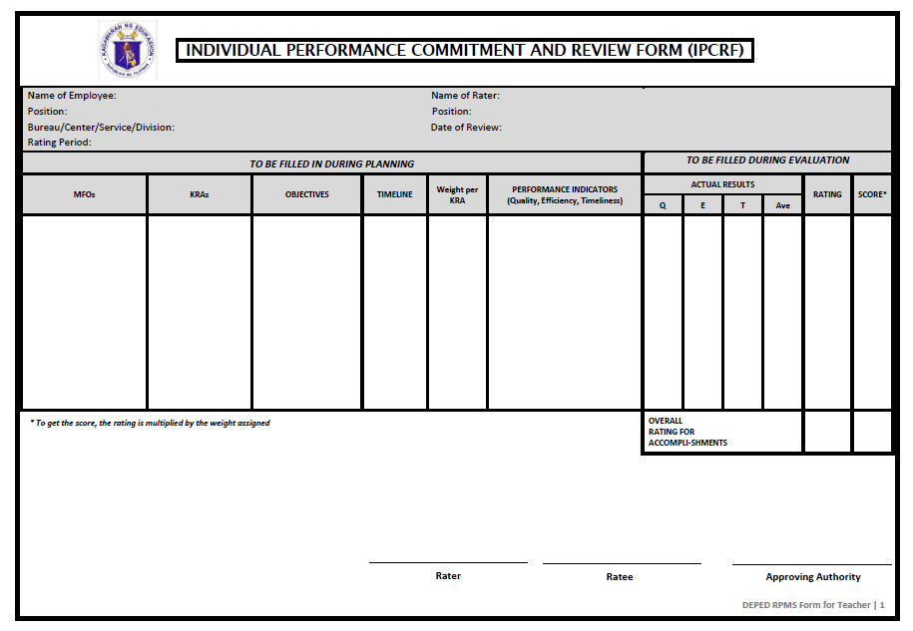

Slide 5
1.4 Reaching Agreement
Once the form is completed :
KRAs + Objectives + Performance Indicators
+ Competencies
①Rater schedules a meeting with Ratee.
②They agree on the listed KRAs, Objectives, Performance Indicators and assigned Weight per KRA.
③Decide what competencies to focus on.

Slide 6
Rater and Ratee agree on the:
① Key Result Areas (KRAs);
② Objectives;
③ Performance Indicators; and
④ Weight Per KRA
and sign the Performance Commitment and Review Form (PCRF).

Slide 7
TIMELINE
Performance Planning and Commitment-
May- June
Performance Monitoring and Coaching-
Year- round
Performance Review and Evaluation- December
Performance Rewarding and Development Planning-
April 1-7, 2018- Rating schedule for School
April 15, 2018- Last day of submission

Slide 8
TIMELINE
April 1-7, 2018- Rating schedule for School
April 15, 2018- Last day of submission

