Slide 1
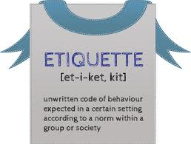
Intensive Training on Social Graces and Etiquette
SACEDA YOUTH LEAD
2015

Slide 2
History of Etiquette
Social graces and Etiquette started in
14th Century France during the reign of
King Louis XIV.
Une ticket or simply etiquette was a social behavior that was to be observed by French people when they are invited to social gatherings.

Slide 3
INDVIDUAL ROLES / INDIVIDUAL POWERS
INTELLIGENCE | SKILLS | VALUES
LINGUISTIC | Reading, Writing, Speaking, Listening, Spelling, editing, emceeing, narrating, news-casting, Dj, declaiming, debate, discourse… | -------------
LOGIC / MATH | Logic, math, analysis, accounting, engineering, plumbing, carpentry | SINCERITY
SPATIAL | Organization, direction, sequencing, driving | HUMILITY
KINESTHETIC | All sports skills- Run Swim Walk | RESPECT
MUSIC AND ARTS | Physical, Mental, Abstract, Culinary, Black Playing of Musical Instruments, Singing, Dancing
INTERPERSONAL | Personal Grooming, Social Graces and Etiquette, Diplomacy and International Culture | ------------
INTRAPERSONAL | Essence of having a God Faith and religiosity | Arrogance/ pride

Slide 4
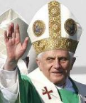
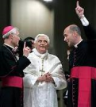
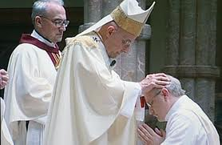
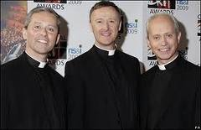
Protocol Tools Titles & Forms of Address:
TITLE | ADDRESS
Pope (Catholic Only) | Your Holiness
Cardinal | Your Eminence
Archbishop | Your Grace
Bishop | Your Worship
Priest | Father

Slide 5
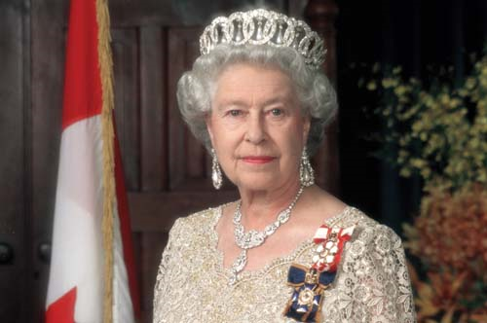
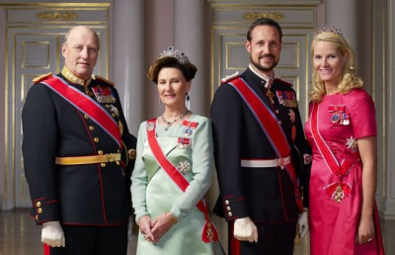
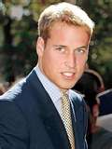
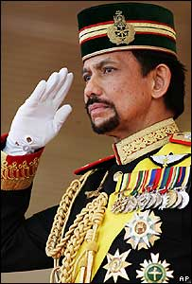
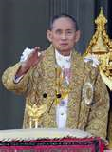
Protocol Tools Titles & Forms of Address:
Masculine | Feminine | Address
King | Queen | Your Majesty
Prince | Princess | Your Highness
Duke | Duchess | Your Grace
Marquis | Marchioness | Your Honor
Earl | Countess | My Lord/Lady Earl
Baron | Baroness | My Lord / Lady
Knight | None | Sir + Name
Local Gentry | Local Gentry | Your Worship
Commoner | Commoner | Master/Mistress

Slide 6
ACADEMICS
Professors are senior academics. Teachers can be called as Sir or Madam.
Emeritus professors are professors who are officially retired, but still active within their universities.
The chief executive of the university is generally known as the Vice-Chancellor (sometimes the Principal or President. Deans are heads of faculty.
The Chancellor of the university is normally a prominent public figure, who acts as a ceremonial figurehead

Slide 7
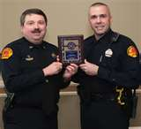
THE POLICE SERVICE
Commissioner
Deputy Commissioner
Deputy Assistant Commissioner
Commanders
Chief Superintendent
Superintendent
Chief Inspector
Inspector
Sergeant
Constable
For Criminal Investigation Department (CID) officers, male and female, add the prefix 'Detective' in the ranks from Constable to Chief Superintendent.

Slide 8
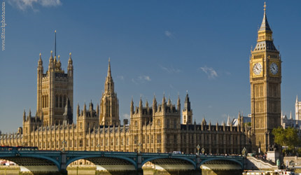
GOVERNMENT SERVICE
The Cabinet is composed of senior government ministers chosen by the Prime Minister. Most cabinet members are heads of government departments, and therefore have the title "Secretary of State".
Mr. President, Madam President…
Senator, Congressman, Governor, Mayor, Councilor or simply Honorable…

Slide 9
LEGAL
Chief Justice, Justices, Judges
Attorneys or Lawyers or Counsellors

Slide 10
MEDICAL PROFESSION
Intern, Post Graduate Intern
Physician, Doctor
Obstetrician, Gynecologist
Cardiologist, Pulmonologist
Diabetologist, Internist,
Oncologist,
Biologist, Climatologist, Physicist,
Sociologist, Zoologist, etc…

Slide 11
DIPLOMATIC SERVICE
Most Ambassadors represent their government in a single country.
Underneath the Ambassador in the diplomatic hierarchy come the following: Minister; Minister-Counsellor; Counsellor; First Secretary; Second Secretary; Third Secretary; Attaché; Assistant Attaché.
The Chargé d'Affaires is normally the Ambassador's second-in command, and is responsible for the diplomatic mission in the absence of a more senior diplomat.
A Consul is appointed to represent the government of one state in the territory of another, and is responsible for looking after the welfare of the citizens of his/her own country in a foreign land.

Slide 12
Titles | Ordinary /Untitled | Royalty | Phil. Education
Beginning of Letter | Dear Mr. James Brown | Dear Duke/Duchess of York | Dear Mr. Mario C. Andong
End of Letter | Yours sincerely | Yours sincerely | Your sincerely
Envelop | Mr. John Brown/ Mr. Brown | The Duke and Duchess of York | Mr. Salustiano Jimenez, Ll.B SDS
Verbal Communication | Mr. John Brown | The Duke and Duchess of York | Mr. Superintendent
Joint Invitation | Mr. and Mrs. Brown | The Duke and Duchess of York | Mr. and Mrs. Mario C. Andong
Description in Conversation | Mr. Brown | The Duke and Duchess | Dr. Velez; Madam Superintendent
Listings | Mr. Brown | The Most Noble Duke and Duchess of York | Supt. Jimenez
Name of Card | Mr. John Brown | The Duke and Duchess of York | Mr. Salustiano Jimenez

Slide 13
Master Protocol
Plan and execute detailed programs for visitors of the school and accompany them in school visits and meetings at Dep Ed or any other offices.
Accompany the Principal/SDS on all official visits; coordinate planning with Dep Ed office, and other key officials
Make arrangements for and accompany delegations in inaugurals, funerals, weddings, and other celebrations locally and internationally.

Slide 14
Master Protocol
Certify and pay the expenses of the foregoing and other activities authorize by Dep Ed.
Oversee the accreditation of Dep Ed and organize presentations of their credentials.
Act as the SDS personal representative and liaison to the other ES, Executives and representatives of agencies in the Philippines.

Slide 15
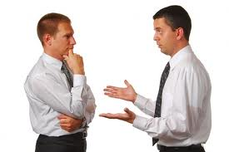
Master Protocol
Arrange the programs of the Dep Ed/ School in accordance to standards and practices.
Administer oaths to Principals, HQPS and teachers
Organize linkages for small schools
Plan and execute the SDS and the Secretary and the Presidents official policies for the pupils and students.

Slide 16
Master Protocol
Help SDS implement programs of the Dep Ed National Office;
Serve as bridge of teachers to SDS and Dep Ed National Office
Conduct programs for total human development with Dep Ed.
Suggest official gifts to be given and maintain records for reports.
Coordinate arrangements for visitors to Dep Ed.
Host visitors and dignitaries with the correct and standard social graces and etiquette.

Slide 17
Key Events Ceremonies, Sequencing and Structures
On stage, the flag is always on the right as you face the audience; the Philippine National Anthem will be sung last if it is the host country.
Prayers, National Anthem or vice versa
There must be a audition for intermission numbers presentation
PA System must be well-checked; not too much echo; backdrop must be well placed; Mics must be tested before program starts.
Not all invited guests are speakers; keep it only to few speakers who can deliver well.
Cocktails can follow after; observe proper etiquette and social graces when eating.
Flags, Anthems and Logos
Program Sequencing
Intermission Numbers
Logistics-PA/ Backdrop
Invited Guests
Reception

Slide 18
OUTCLASS THE COMPETITION
Business Entertaining
Invitations
Receiving Lines
Host Duties
Guest Duties
Seating Guidelines
Napkin Placement
Toasting
Silverware Savvy
Dining Dos and Don’ts

Slide 19
INVITATIONS
What is the occasion?
When is the occasion?
Where is the occasion?
Who is to be invited in the occasion
Style of occasion?
Meaning of R.S.V.P.
Most formal: With Invitation
Less formal: Text; verbal

Slide 20
HOST DUTIES
Welcome guests with positive greeting and aura.
Direct guests and assign one focal person to accompany him/her in the event
You can’t be with him all the times
See to it that program of events will be followed strictly. No inato system.
Provide ventilation and clean comfort rooms

Slide 21
Guest Duties
Please arrive on time. Do not create a show just because you are the guest.
Approach host with powerful handshakes and smile. Try to blend in asap.
Observe set ups of the host; Be flexible and try to understand new set ups.
Try to make connections to establish a common ground.

Slide 22
SEATING GUIDELINES
Seating arrangements depends on occasion and table used.
PRESIDENTIAL TABLE- Guest will seat in the middle and is flank by the hosts
RECTANGULAR TABLE- Guest will seat in the middle with the host in front of him.
Note: Other members of the entourage may seat any part of the table. Please take
Note that the most important people are the guest and the host/counterpart leader.

Slide 23
OUTCLASS THE COMPETITION
 | Eye Contact How to Make an Entrance The Ultimate Greeting Introductions Handshaking Remembering Names Conversation Skills Business Card Protocol Electronic Communications

Slide 24
HERMINIA T. YAP
Headquater Principal, Pintuyan Central School
Department of Education- Division of Southern Leyte
Pintuyan, Southern Leyte The Philippines
Telephone: (35) 225 2449
Mobile: (63) 915 834 2342
Email: hermiegoestodeped@yahooo.com

Slide 25
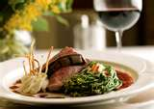
DINE LIKE A DIPLOMAT
Host and Guest Duties Styles of Eating Taking Your Seat and Napkins Toasting | World-Class Dos and Don’ts Eating Various Foods Tipping Seating Guidelines

Slide 26
GLOBAL AWARENESS

Slide 27
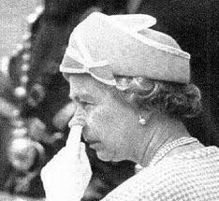
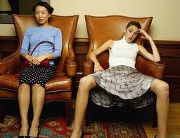
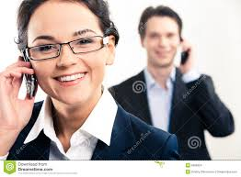
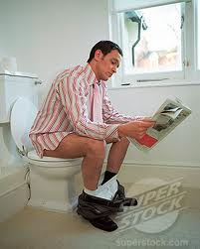

Slide 28
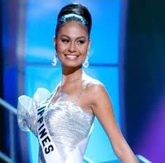
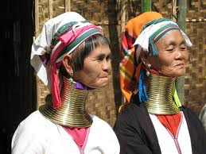

Slide 29
How to Succeed in the International Arena
Global Awareness Proﬁle Appropriate Business Attire Importance of Rank and Status Business Customs and Terminology Interaction Intelligence World-Class Handshakes | Global Communication Styles and Conversation Skills Remembering Names Gift Giving High- and Low-Context Cultures Strategic Dos and Don’ts

Slide 30
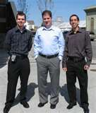
BUSINESS ATTIRE
PASTEL COLORS SELECTION
SOLID NAVY BLUE FOR MEN

Slide 31
Dress
for
Success
series

Slide 32
impression
First

Slide 33
What’s in it for me?
What is first impression?
Why is it important?
How to create a good first impression?

Slide 34
How many seconds do you think first impression is being formed?
3 seconds!

Slide 35
You will never get a second chance to make a good
first impression.
You either
make it or break it.

Slide 36
Self-Presentations
Reader’s Digest Sequence
NAME
PARENTS/ SIBLINGS
ADDRESS
EDUCATION (Basic, College)
Hobbies
Motto

Slide 37
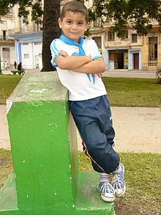
BUILDING CONFIDENCE
Confidence is generally described as a state of being certain either that a hypothesis or prediction is correct or that a chosen course of action is the best or most effective.
Self-confidence is having confidence in oneself.
Arrogance or hubris in this comparison, is having unmerited confidence—believing something or someone is capable or correct when they are not.
Overconfidence or presumptuousness is excessive belief in someone (or something) succeeding, without any regard for failure.

Slide 38
Why is it important to create a good first impression?
Sets the tone for future relationship building
Influences subsequent interactions
Is a powerful perceptive tool

Slide 39
How to create a good first impression?

Slide 40
Physical Appearance
Grooming
Dress Sense
What is your Style?
Self-Confidence
Good Posture
Social Graces/ Etiquette
Intelligences

Slide 41
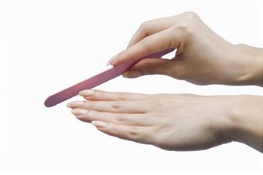
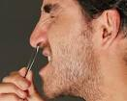
Grooming

Slide 42
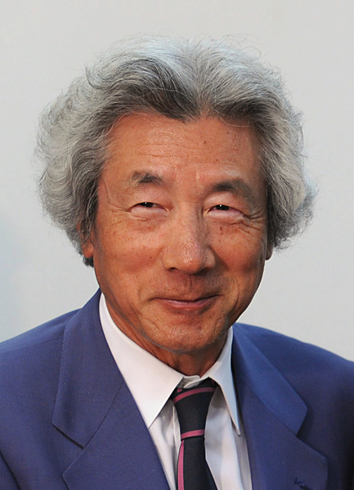
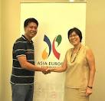
your image speaks…
Signature look:
Long silver hair
Slim silhouette
Well-cut suit
Message
I dare to be different
I take care of my image
I take care of my job
Junichiro Koizumi Dave G. Saceda at
Prime Minister of Japan the ASIA EUROPE
(2001 – 2006) Foundation Meet

Slide 43
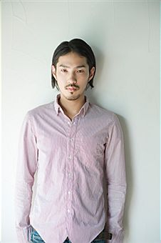
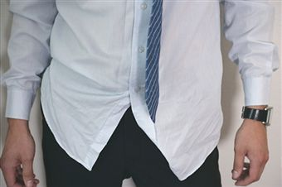
image destroyers
Message:
“I can’t be bothered.”

Slide 44
image destroyers
Message:
“I am sexy, fun and playful. I am an attention seeker.”

Slide 45
Top 10 image destroyers
Women
Messy hair
Heavy makeup
Platform shoes
Lipstick on teeth
Strong perfume
Scruffy shoes
Revealing clothes
Chipped nail polish
Run in the stockings
VPL
Men
Oily hair
Scruffy Shoes
Crumpled Shirts
Body Odour
Bad Breath
Loose socks
Short trousers
Worn out belt
Poor colour coordination
Nasal hair showing

Slide 46
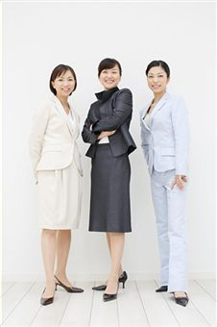
Dress Sense
Style
Colour
Cut
Fit

Slide 47
What is Style?
Style has nothing to do with what you wear. The essence of style is confidence. And you are the one that makes that difference.

Slide 48
What is your Style?
classic
dramatic
romantic
natural

Slide 49
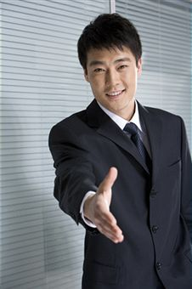
classic

Slide 50
classic
dramatic

Slide 51
classic
natural

Slide 52
classic
dramatic

Slide 53
When you look good, you feel good and will react positively to others. In turn, others will react positively towards you.

Slide 54
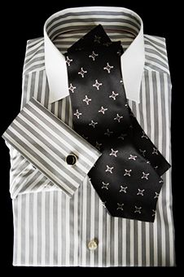
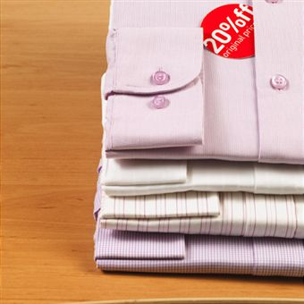
quality vs quantity

Slide 55
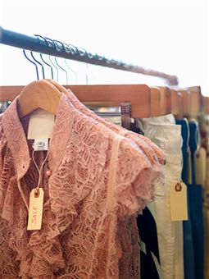
texture

Slide 56
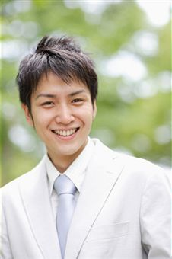
cut & fit

Slide 57
Men
→ Hair
→ Face
→ Nails
→ Dressing
→ Accesories
→ Cologne

Slide 58
Women
→ Hair
→ Face/Makeup
→ Nails
→ Dressing
→ Accesories
→ Perfume

Slide 59
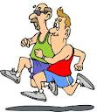
EXERCISE
An adequate exercise at least 30-40 minutes a day that is necessary, beneficial and practical.
A cardio-pulmonary exercise is highly recommended

Slide 60
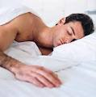
Good Rest and Sleep
Have a good night rest between 6-8 hours a day.

Slide 61
Summary
First Impression:
55% appearance
38% voice
7% words
Never judge a person not until he/she speaks and try to assess his and her values in life...

Slide 62
Thank you and Good Luck to All!
Thank you (English)
Xie Xie (Chinese)
Shukrun (Arabic)
Terimah Kasih (Bahasa)
Ca mon (Vietnamese)
Arigato (Japanese)
Salamat (Tagalog)
Gracias(Spanish)
Merci (French)

Slide 63
Thank You Very Much!
Saceda Youth Lead
SYL Center, Candau-ay 6200
Dumaguete City, The Philippines
Contacts: 0915 633 9546 0936 124 3809
Email: sacedayouthlead@gmail.com
sacedatravels@gmail.com
FB: syl.school@yahoo.com
www.sacedayouthleadblogspot.com

