Slide 1
DEPED ORDER NO. 2, s. 2015
GUIDELINES ON THE ESTABLISHMENT AND IMPLEMENTATION OF THE RESULTS- BASED PERFORMANCE MANAGEMENT SYSTEM (RPMS) IN THE DEPARTMENT OF EDUCATION

Slide 2
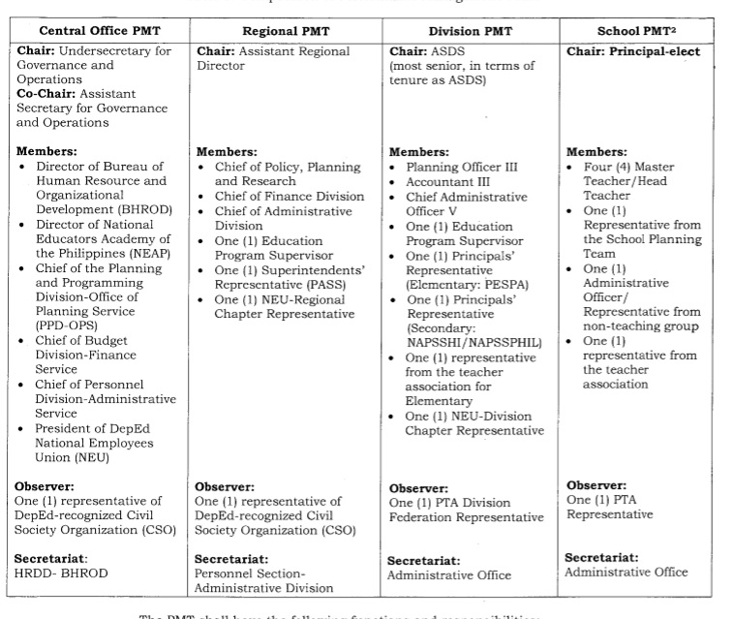
COMPOSITION OF THE PERFORMANCE MANAGEMENT TEAM

Slide 3
Central Office PMT | Regional PMT | Division PMT | School PMT
Chair: Undersecretary for Governance and Operations Co-chair: Assistant Secretary for Governance and Operations Members: Director of Bureau of Human Resource and Organizational Development (BHROD) Director of National Educators Academy of the Philippines (NEAP) Chief of the Planning and Prgramming Division- Office o Planning Service (PDD- OPS) Chief of Budget Division- Finance Service Chief of Personnel Division- Administrative Service President of DepEd National Employees Union (NEU) Observer: One (1) representative of DepEd- recognized Civil Society Organization (CSO) Secretariat: HRDD- BHROD | Chair: Assistant Regional Director Members: Chief of Policy, Planning an Research Chief of Finance Division Chief of Administrative Division One (1) Education Program Supervisor One (1) Superintendents’ Representative (PASs) One (1) NEU- Regional Chapter Representative Observer: One (1) representative of DepEd- recognized Civil Society Organization (CSO) Secretariat: Personnel Section- Administrative Division | Chair: ASDS (most senior, in terms of tenure as ASDS) Members: Planning Officer III Accountant III Chief Administrative Officer V One (1) Education Program Supervisor One (1) Principals’ Representative (Elementary: PESPA) One (1) Principals’ Rerpresentative (Secondary: NAPSSHI/ NAPSSPHIL) One (1) representative from the teacher association for Elementary One (1) NEU- Division Chapter Representative Observer: One (1) PTA Division Federation Representative Secretariat: Administrative Officer | Chair: Principal- elect Members: Four (4) Master Teacher/ Head Teacher One (1) Representative from the School Planning Team One (1) Administrative Officer / Representative from non- teaching group One (1) representative from the teacher association Observer: One (1) PTA Representative Secretariat: Administrative Office

Slide 4
COMPOSITION OF THE GRIEVANCE COMMITTEE
Central Office | Regional Office | Schools Division Office | Schools
Chair: Undersecretary for Legal and Legislative Affairs Members: Director of Administrative Service DepEd NEU President | Chair: Regional Director Members: Legal Officer HRMO EPS Accountant PESPA representative NEU | Chair: SDS Members: Legal Officer HRMO EPS Accountant PESPA representative NEU | Chair: ASDS Members: PSDS HRMO/ AO Principal* Master Teacher/ Head Teacher * Teachers Association*

Slide 5
RATEE | RATER | APPROVING AUTHORITY
PRINCIPAL/ SCHOOL HEAD | PSDS | ASDS
SEC. HEAD TEACHER | PRINCIPAL | PSDS
MASTER TEACHER | PRINCIPAL | PSDS
ELEM. TEACHER SEC. TEACHER | PRINCIPAL/ SCHOOL HEAD DEPT. HEAD/HEAD TEACHER | PSDS PRINCIPAL
NON- TEACHING STAFF | PRINCIPAL | ADMINISTRATIVE OFFICER V (Administrative Services)

Slide 6
RATING THE PRINCIPALS/ SCHOOL HEADS
CHIEF EDUCATION SUPERVISORS OF CID AND SGOD
MAY GIVE THEIR OBSERVATIONS TO BE FURNISHED TO THE ASDS

Slide 7
DEPED ZN WEBSITE
www.depedzn.net
Please click “Contact Us” Button on our website to post your feedback/ concerns

