Slide 1
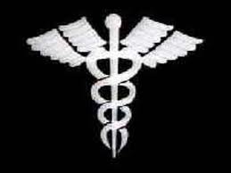
Emergency and Preventive Medicine
Brought to you by:
SACEDA YOUTH LEAD
A Decade of Empowering Leaders of Tomorrow
GBM VGS DGS

Slide 2
STRESS MANAGEMENT
Some kinds of diseases are caused by things people do.
Smoking can cause cancers of the lungs, mouth, throat, bladder, kidneys
and several other organs, as well as heart disease and stroke. While not
everyone who smokes will get cancer, smoking increases a person's
chance of getting the disease.
Drinking a lot of alcohol has also been shown to increase a person's
chance of getting cancer of the mouth, throat, and some other organs. This
is especially true if the person drinks and smokes.
Overeating can lead one to diabetes or having hypertension.
Radiation (x-rays) can cause cancer. But the x-rays used by the doctor or
dentist are safe. Too much exposure to sunlight without any protection can
cause skin cancer.

Slide 3
STRESS MANAGEMENT
Sensory: pain, bright light
Life events: birth and deaths, marriage, and divorce
Responsibilities: lack of money, unemployment
Work/study: exams, project deadlines
Personal relationships: conflict, deception
Lifestyle: heavy drinking, insufficient sleep
Early life exposure (e.g. child abuse) can permanently alter an individual's stress response
Environmental: Lack of control over environmental circumstances, such as food, housing, health, freedom, or mobility

Slide 4
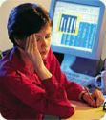
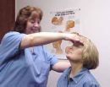
RECURRING HEADACHE
A recurring headache warrants
a complete neuro exam.
Kinds of Headache:
Tension Headache, Migraine, Error of Refraction or any cerebral problem

Slide 5
RECURRING HEADACHE
Ear, nose and throat disorders There are many disorders of the ear, nose and throat that can cause recurring headache
Sinus problems - caused by infection, cold, flu or allergic reactions such as hayfever.
Labyrinthitis - the general term for any type of inflammation of the inner ear.
Infection - of the ear, nose or throat, caused by either bacteria or viruses.
Trauma - such as blows to the ear, or perforation of the ear drum.
Hayfever - when the immune system overreacts to such irritants as pollen.
Tonsillitis - an infection most often caused by the bacterium streptococcus.
Tumors - brain tumor is a relatively rare cause of recurrent headache.

Slide 6
RECURRING HEADACHE
Poor posture - which puts unnecessary strain on the muscles of the back and neck.
Hangover - caused by abuse of alcohol or drugs.
Temperature - extremes of heat and cold.
Dehydration - which affects blood pressure.
Noise - especially loud noises.
Temporal arteritis - inflammation of the artery at the temple, most common in elderly people.

Slide 7
THROAT AND VOICE
While anyone can develop a voice problem, your risk is greatest if your job puts a high demand on your vocal cords. For example, singers, preachers, and teachers have high-risk jobs. Aging also strains the vocal cords. If you scream or talk loudly, you increase your risk of developing voice problems. If you have ever had surgery on or near your vocal cords, are a smoker, or have had throat cancer, your risk for developing scar tissue and future voice problems increases as well

Slide 8
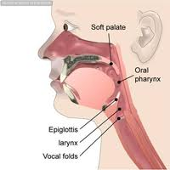
Throat and Voice
The voice is the sound made when the vocal cords vibrate due to the passage of air through the larynx. The sound made by the cords is amplified and shaped when it passes through the nose and mouth.
Common symptoms of a voice problem include hoarseness or raspy-sounding speech;
The most common cause of a voice problem is an upper-respiratory infection such as a cold. But voice problems can be related to anything from acid reflux to cancer to nerve damage.
Cancer of the throat, nasal pharyngeal, laryngeal

Slide 9
Throat and Voice
For teachers, please take care of your voices and throat by:
Drinking plenty of liquids in between classes.
Modulate your voices
Don’t shout and overwork your vocal chords.
Cover mouth and nose when you erase your writing on the boards, chalk dust can be a precipitating factor.

Slide 10
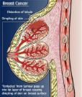
BREAST RELATED PROBLEMS
A change in appearance or any sensation of the nipple, that is, if there is any itching, any enlargement or the nipple is retracted.
Enlargement, pain in the breast, or any discomfort on only one side.
Change in the feel or color of the skin of the nipple, or areola or the breast itself, that is, a redness, veins on breast surface are accentuated, scaly; dimpled or puckered and a retracted appearance.
Some symptoms of an advanced case of the disease are weight loss, bone pain, skin ulceration and swelling of one arm.

Slide 11
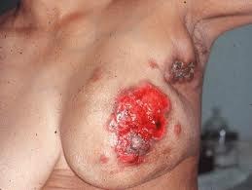
BREAST RELATED PROBLEMS
Of the above-mentioned symptoms there are some that most women are not aware of that are actually symptoms of breast cancer. They are:
An itchy breast
A breast that constantly feels warm or hot to the touch - This is a symptom of the rare and dangerous breast cancer known as inflammatory breast cancer.
A flat or an inverted nipple - Sometimes individuals have an inverted nipple from birth, this does not count as a symptom.

Slide 12
Breast Related Problems

Slide 13
Breast Related Problems

Slide 14
BREAST RELATED PROBLEMS

Slide 15
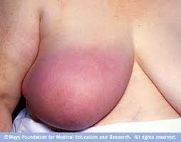
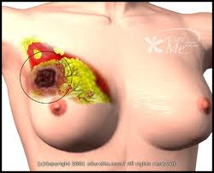
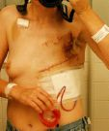
Breast Related Problems

Slide 16
BREAST RELATED PROBLEMS
Some common symptoms of breast cancer in men:
Even though breast cancer is more common amongst women, men too can get breast cancer. It is estimated that over 1600 men in the United States alone get breast cancer each year. Some symptoms of breast cancer in men include:
Swelling in breast, chest wall or nipple
A lump
A discharge from the nipple
Inversion of the nipple, that is, the nipple turns inward
Dimpling or puckering of the skin of the breast
The skin of the breast or the nipple has a reddish appearance or it has a very scaly and dry appearance.

Slide 17
Self-Breast Exam

Slide 18
MAMMOGRAPHY

Slide 19
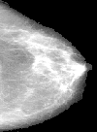
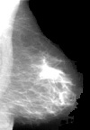

Slide 20
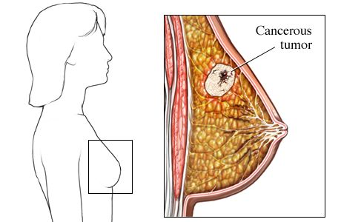
Self Breast Exam

Slide 21
Breast Related Problems

Slide 22
Breast Related Problems

Slide 23
Breast Related Problems

Slide 24
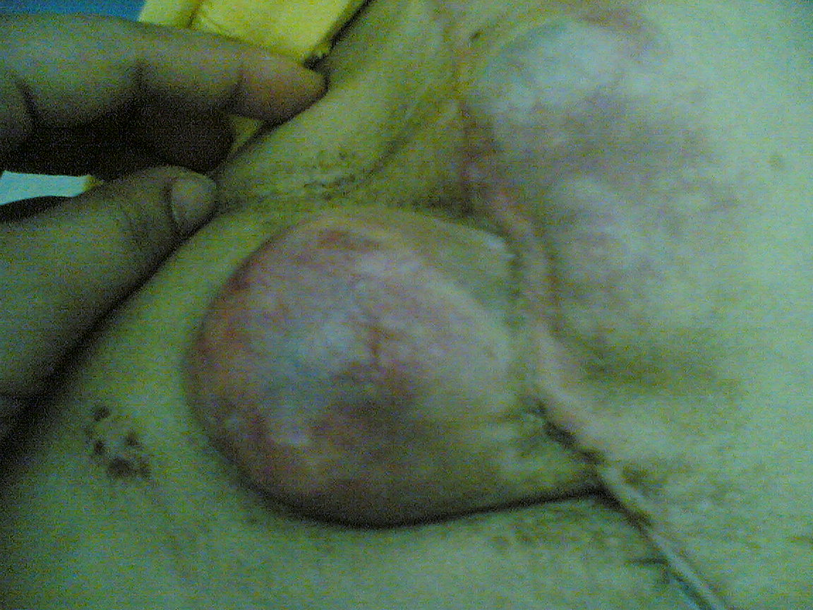
Breast Related Problems

Slide 25
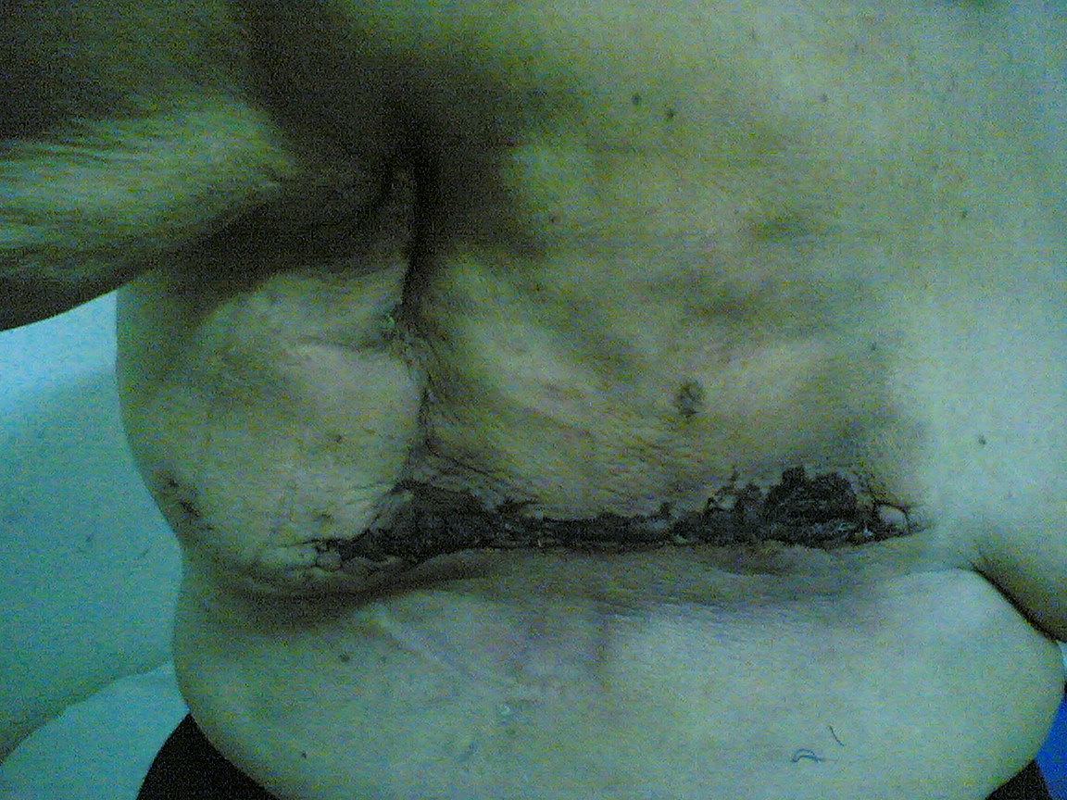
Types of Surgery

Slide 26
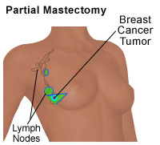
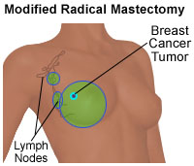
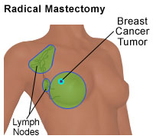
Types of Surgery

Slide 27
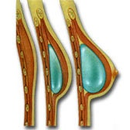
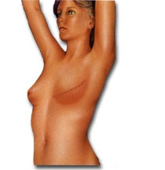
Types of Surgery

Slide 28
Hypertension

Slide 29
Hypertension

Slide 30
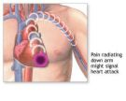
Heart Attack
Heart Attack
(Myocardial Infarction)
What is a heart attack?
A heart attack (myocardial infarction) is the death of heart muscle due to the loss of blood supply. Usually, the loss of blood supply is caused by a complete blockage of a coronary artery(an artery that supplies blood to the heart muscle) by a blood clot.

Slide 32
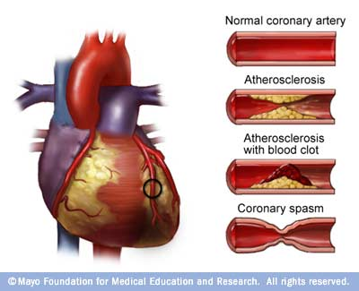
CAUSES OF HEART ATTACK
A heart attack is almost always caused by the formation of a blood clot on a cholesterol plaque located on the inner wall of an artery to the heart (coronary artery). It is believed that the process of formation of these plaques starts in the late teens. Over a period of time the accumulation of cholesterol plaque causes thickening of the artery walls and narrowing of the arteries; a process called atherosclerosis. Many factors have been found to influence this plaque formation. It can be accelerated by smoking, high blood pressure, elevated cholesterol, and diabetes. Whereas, factors like exercise, low fat diet, avoiding stress seem to help in retarding this process.

Slide 33
Features of Heart Attack
Anxiety: fear of impending death. Breathlessness, Nausea and vomiting, Sweating, pallor and a fast pulse.
Pressure Points: Illicit Pains in the following areas for fainting:
Nail Beds, Eyebrows, sternum and nipples.

Slide 34
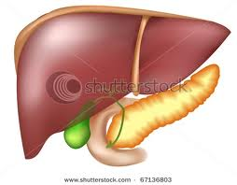
DIABETES
Diabetes is a disease in which blood glucose levels are above normal.
Most of the food we eat is turned into glucose, or sugar, for our bodies to use for energy.
The pancreas, an organ that lies near the stomach, makes a hormone called insulin to help glucose get into the cells of our bodies.
When you have diabetes, your body either doesn't make enough insulin or can't use its own insulin as well as it should. This causes sugar to build up in your blood.

Slide 35
SYMPTOMS OF DIABETES
Excessive eating
Unexplained weight loss
Feeling very tired much of the time
Excessive thirst
Excessive urination
Very dry skin
Sores that are slow to heal
More infections than usual.
Tingling sensation or numbness
POLYPHAGIA
POLYDIPSIA
POLYURIA
3 P’s

Slide 36
Diabetes

Slide 37
TYPES OF DIABETES
Type 1 diabetes, which was previously called insulin-dependent diabetes mellitus (IDDM) or juvenile-onset diabetes, may account for 5% to 10% of all diagnosed cases of diabetes.
Type 2 diabetes, which was previously called non-insulin-dependent diabetes mellitus (NIDDM) or adult-onset diabetes, may account for about 90% to 95% of all diagnosed cases of diabetes.
Gestational diabetes is a type of diabetes that only pregnant women get. If not treated, it can cause problems for mothers and babies. Gestational diabetes develops in 2% to 5% of all pregnancies but usually disappears when a pregnancy is over.
Other specific types of diabetes resulting from specific genetic syndromes, surgery, drugs, malnutrition, infections, and other illnesses may account for 1% to 2% of all diagnosed cases of diabetes

Slide 38
Diabetes

Slide 39
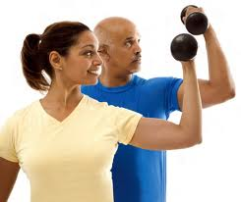
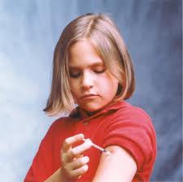
TREATMENT OF DIABETES
Healthy eating, physical activity, and blood glucose testing are the basic therapies for type 2 diabetes. In addition, many people with type 2 diabetes require oral medication, insulin, or both to control their blood glucose levels.
People with diabetes must take responsibility for their day-to-day care, and keep blood glucose levels from going too low or too high.
In addition, people with diabetes may see endocrinologists, who may specialize in diabetes care; ophthalmologists for eye examinations; podiatrists for routine foot care; and dietitians and diabetes educators who teach the skills needed for daily diabetes management

Slide 40
Diabetes

Slide 41
BOWEL MOVEMENT

Slide 42
URINARY TRACT INFECTIONS
A urinary tract infection (UTI) is an infection that begins in your urinary system. UTIs limited to your bladder can be painful and annoying. But serious consequences can occur if the infection spreads to your kidneys.
Women are most at risk of developing a UTI. In fact, half of all women will develop a UTI during their lifetimes, and many will experience more than one.

Slide 43
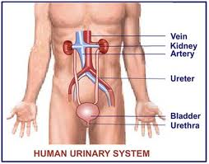
URINARY SYSTEM

Slide 44
SYMPTOMS OF UTI
Not everyone with a UTI develops recognizable signs and symptoms, but most people have some. These can include:
A strong, persistent urge to urinate
A burning sensation when urinating
Passing frequent, small amounts of urine
Blood in the urine (hematuria) or cloudy, strong-smelling urine

Slide 45
Acute pyelonephritis. Infection of your kidneys may occur after spreading from an infection in your bladder. Kidney infection can cause upper back and flank pain, high fever, shaking chills, and nausea or vomiting.
Cystitis. Inflammation or infection of your bladder may result in pelvic pressure, lower abdomen discomfort, frequent, painful urination and strong-smelling urine.
Urethritis. Inflammation or infection of the urethra leads to burning with urination. In men, urethritis may cause penile discharge

Slide 46
UNDERSTANDING THE V
Urinary tract infections typically occur when bacteria enter the urinary tract through the urethra and begin to multiply in the bladder. The urinary system has infection-fighting properties that inhibit the growth of bacteria and is designed to keep out such microscopic invaders. However, certain factors increase the chances that bacteria will enter the urinary tract, take hold and multiply into a full-blown infection.
Having bacteria in the urine doesn't always signify an infection. Some people, especially older adults, may have bacteria in the urine without any signs or symptoms of infection. This condition, known as asymptomatic bacteriuria, doesn't need treatment.

Slide 47
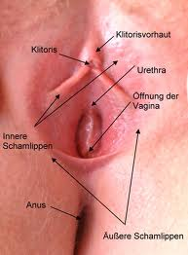
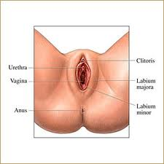
Causes of UTI
Personal Hygiene and Care
of your Vagina

Slide 48
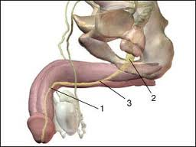
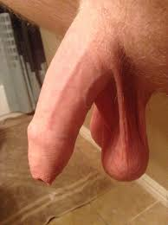
URINARY SYSTEM

Slide 49
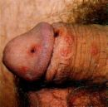
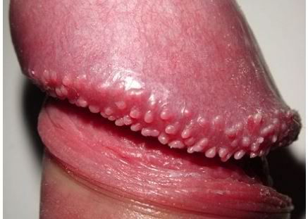
CAUSES OF UTI
In men, urethritis often is the result of bacteria acquired through sexual contact. The majority of such infections are caused by gonorrhea and chlamydia.

Slide 50
PREVENTION OF UTI
You can take steps to reduce your risk of urinary tract infections. Women in particular may benefit from the following:
Drink plenty of liquids, especially water. Cranberry juice may have infection-fighting properties. However, don't drink cranberry juice if you're taking the blood-thinning medication warfarin. Possible interactions between cranberry juice and warfarin can lead to bleeding.
Urinate promptly when the urge arises. Avoid retaining your urine for a long time after you feel the urge to void.
Wipe from front to back. Doing so after urinating and after a bowel movement helps prevent bacteria in the anal region from spreading to the vagina and urethra.
Empty your bladder as soon as possible after intercourse. Also, drink a full glass of water to help flush bacteria.
Avoid potentially irritating feminine products. Using deodorant sprays or other feminine products, such as douches and powders, in the genital area can irritate the urethra.

Slide 51
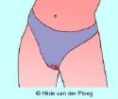
VAGINAL SPOTTING
Discharges from the vagina that can be visible in one’s underwear…
WBC, Pus, Blood

Slide 52
VAGINAL SPOTTING
Women expect vaginal bleeding as the uterus sheds its lining during menstruation. What's considered normal vaginal bleeding varies from woman to woman. One woman may have a period every 21 days, bleed for a few days and lose only a few teaspoonfuls of blood. Another woman may have her period only every 35 days, bleed for more than a week and lose several teaspoonfuls of blood. Both are within normal ranges of vaginal bleeding in the average premenopausal woman.
But unexpected vaginal bleeding could indicate a problem of the vagina, cervix or uterus, especially if you're postmenopausal. When might vaginal bleeding be a cause for concern?

Slide 53
VAGINAL SPOTTING
WHAT IT IS INDICATIVE OF…
Irregular vaginal bleeding could indicate one of the following diseases or conditions:
Menstrual dysfunction
Fluctuating hormone levels
Vaginal infection
Tumors, polyps or fibroids of the vagina, cervix, uterus or fallopian tubes

Slide 54
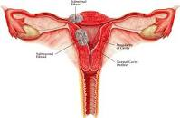
Vaginal Spotting/ Uterine Prolapse
Cervical disorders — such as cervical ectropion, a condition common among younger women, especially young women taking birth control pills — in which the cervical tissue becomes more susceptible to abrasion, often associated with bleeding after sexual intercourse
Cancer of the uterus, cervix, vagina or vulva
Vaginal injury from trauma or sexual abuse

Slide 55
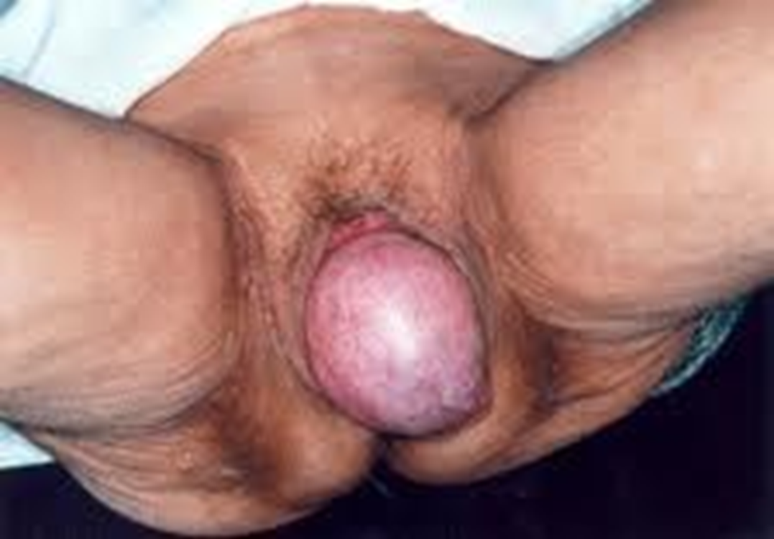
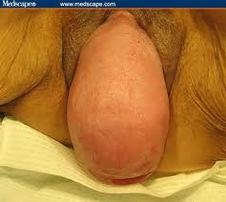
UTERINE PROLAPSE

Slide 56
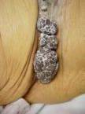
Vaginal Spotting
Some sexually transmitted diseases, such as chlamydia, gonorrhea or genital warts
Complications from pregnancy, such as miscarriage or ectopic pregnancy

Slide 57
Vaginal Spotting
Does irregular vaginal bleeding mean you have cancer?
In most cases, irregular vaginal bleeding is due to a noncancerous (benign) condition. In premenopausal women, irregular vaginal bleeding is often the result of hormonal fluctuations and not a malignancy.
In older women, particularly postmenopausal women, vaginal bleeding may be associated with a gynecologic cancer, but the bleeding could instead be due to a noncancerous condition. Certain risk factors exist for uterine, cervical and vaginal cancers. Talk with your doctor about whether you're at increased risk of these cancers.

Slide 58
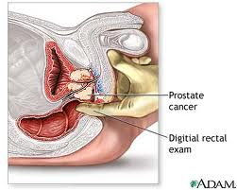
Prostate Problem

Slide 59
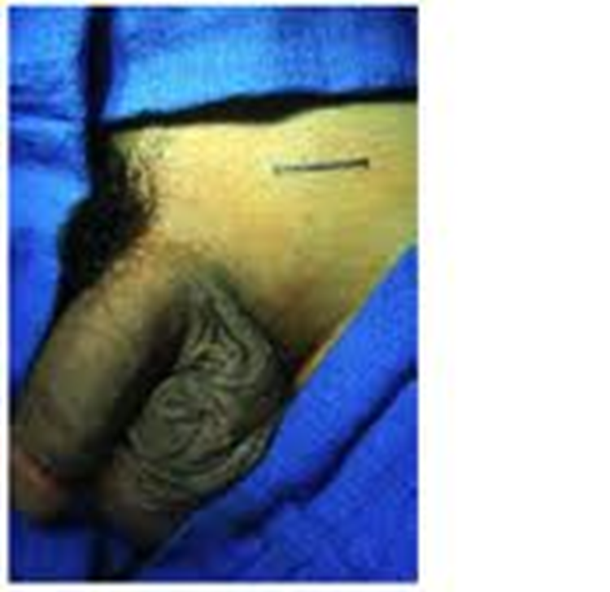
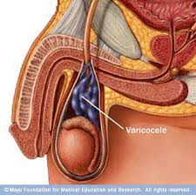
TESTICLE PROBLEM
VARICOCELE

Slide 60
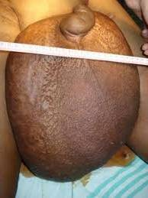
TESTICLE PROBLEM
PENILE AND TESTICULAR ELEPHANTIASIS

Slide 61
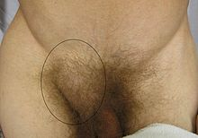
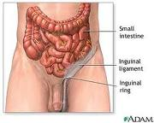
HERNIAS
An inguinal hernia is a protrusion of abdominal-cavity contents through the inguinal canal. They are very common (lifetime risk 27% for men, 3% for women), and their repair is one of the most frequently performed surgical operations.

Slide 62
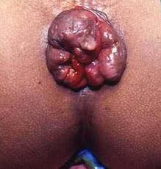
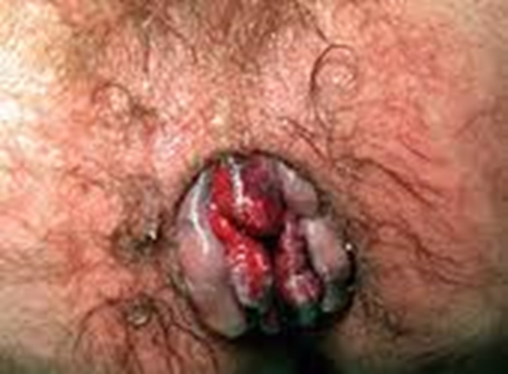
Hemorrhoids

Slide 63
CANCER
…is a group of disease characterized by uncontrolled cell proliferation. . When cells in a part of the body divides without control, the excess tissue that develops is a tumor which can be cancerous or harmless. Malignant tumors have the ability to undergo metastasis, the spread of cancerous cells to other parts of the body

Slide 64
Cancer
C hange in bowel or bladder habits A sore that does not heal U nusual bleeding or discharge T hickening/lump in any part of the body I ndigestion or difficulty swallowing O bvious change in a wart or mole, or N agging cough or hoarseness

Slide 65
Types of Cancer
CARCINOMAS-malignant cancers tumors that arise from epithelial cells.
MELANOMAS-cancerous growths of melanocytes, skin epithelial cells that produce melanin.
SARCOMA-cancer arising from muscle cells or connective tissues.
OSTEOGENIC SARCOMA-cancer of the bone tissue.
LEUKEMIA-cancer of blood forming organs characterized by rapid growth of abnormal leukocytes (WBC)
LYMPHOMA-malignant disease of lymphatic tissue

Slide 66
CANCER

Slide 67
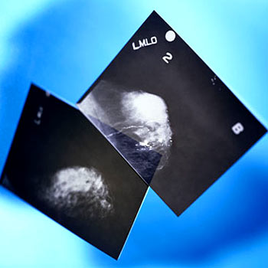
Cancer Suspects
GENETICS
HEREDITARY

Slide 68
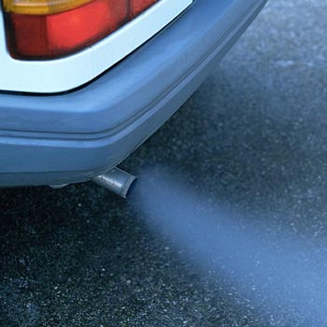
Cancer Suspects
Tailpipe Toxins
At the top of the list of common, potent mammary carcinogens are components of car and truck exhaust. Included on this list are PAHs (polycyclic aromatic hydrocarbons)—products of combustion—which have been linked to breast cancer in men as well as women.

Slide 69
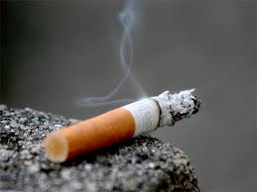
Cancer Suspects
Tobacco Smoke
Like car and truck exhaust, tobacco smoke is a source of many PAHs. Among these are dibenz[a,h]anthracene, considered by EPA to be “probably carcinogenic to humans” as well as mutagenic—meaning that it can cause genes to mutate. It’s laced with many other cancer-causing substances as well, such as dibenzo [def,p]chrysene.
.

Slide 70
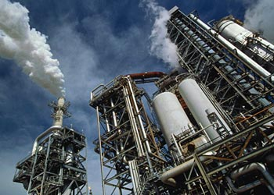
CANCER SUSPECTS
Industrial Combustion Sources
Air pollution from refineries and coal plants also compounds the load, thus suggest that exposure in early life to high levels of PAHs may increase one's risk of postmenopausal breast cancer.

Slide 71
CANCER SUSPECTS
Drinking Alcohol
Excessive drinking alcohol
can lead to liver cirrhosis

Slide 72
CANCER SUSPECTS
Toxicants in Food
Food can be tainted by pesticides sprayed on crops, antibiotics used on poultry and other meats, and hormones injected into cattle, sheep and hogs.
Acrylamides—found in French fries, breads and cereals cooked at very high temperatures—pose problems, as do foods contaminated by styrene from polystyrene (Styrofoam) containers.
Fish can also be contaminated with a variety of long-banned chemicals like PCBs, which have been linked to breast cancer, as well as by dioxin, a product of incineration.

Slide 73
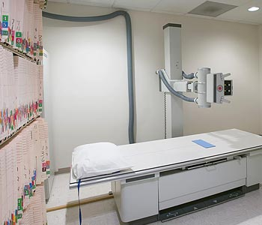
Cancer Suspects
Ionizing Radiation
In 2005, the National Toxicology Program classified x-rays and gamma radiation as causing cancer in humans, but ionizing radiation has long been regarded as the most established environmental risk factor for breast cancer.
Our greatest exposure to radiation is from the gamma rays in natural sunlight, which also provides us with beneficial Vitamin D. We get increased radiation from plane travel, as a result of greater proximity to the sun's rays and because the radiation is less filtered by clouds and particulates. If you live or work close to nuclear power plants or lived in the era of atmospheric testing of nuclear weapons (1945-1980) you will also have accumulated higher doses of this radiation.

Slide 74
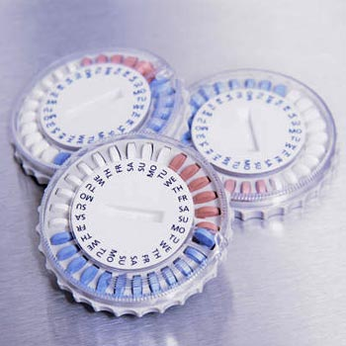
Cancer Suspects
Hormone Supplements
Women’s exposures to natural estrogens over time increases the risk of breast cancer. However, it is only recently that synthetic estrogens and progesterones have been linked to a higher risk for breast cancer.
Hormone Replacement Therapy (HRT), used to alleviate menopausal symptoms, put women at increased risk of breast cancer.

Slide 75
Cancer Suspects
Drinking Water Contaminants
Disinfecting products used to clean water help kill bacteria and keep disease in check.
However, researchers caution that some disinfection byproducts of chlorinating water cause mammary tumors in rodents. There’s strong evidence for their causing cancer in humans as well.
Likewise, many drinking water systems have been found to be contaminated by pesticides and dry cleaning chemicals or tubes are rusted.

Slide 76
Cancer Suspects
Household Chemicals
Stain-resistant and flame-retardant chemicals have found their way into our lives—in our carpeting, furniture, clothing, cookware, cosmetics, lubricants, paints, and adhesives. (perfluorooctanoic acid)
Chlorinated solvents used in paint removers, varnishes, wood sealants, fabric cleaners, dry cleaning chemicals and septic tank cleaners as being suspected human carcinogens.

Slide 77
Cancer Suspects
Gasoline, Benzene, Fuels and Solvents
Occupational studies revealed that petrochemical solvents—increases the risk of having cancer.

Slide 78
Cancer Suspects
Pharmaceuticals
A wide variety of prescription drugs have been found to produce mammary tumors in animals—everything from Reserpine, used for the treatment of mild or moderate hypertension, to Furosemide for pulmonary edema. Many anti-cancer drugs are also known human carcinogens.

Slide 79
Cancer Suspects
Miscellaneous Chemicals, Dyes, Whitening Agents
In January 2003, the federal Centers for Disease Control and Prevention reported their findings on human exposure to environmental chemicals, revealing some 116 toxic and cancer-causing chemicals in the blood and tissues of human volunteers chosen to represent our population. Among the compounds they found were multiple pesticides linked to breast cancer, dioxins that are products of incineration, and other chemicals.
Can our “body burdens” be lightened? Silent Spring researchers advocate reducing as many “preventable” exposures from industrial chemical byproducts as possible. Examples abound: dioxane, a contaminant in detergents and shampoos, for example, and fluorescent whitening agents, both have been found to cause breast cancer in animals.

Slide 80
CANCERS…

Slide 81
CANCER UPDATE
Every person has cancer cells in the body. These cancer cells do
not show up in the standard tests until they have multiplied to a few
billion.
When doctors tell cancer patients that there are no more cancer
cells in their bodies after treatment, it just means the tests are
unable to detect the cancer cells because they have not reached
the detectable size.

Slide 82
CANCER THERAPY

Slide 83
CANCER THERAPY

Slide 84
CANCER UPDATE
SURVIVAL RATE DIFFERENCE IN
BREAST CANCER PER STAGE
5 YR 7-YR
Stage 0: 98% 95%
Stage I: 96% 92%
Stage II: 81% 71%
Stage III: 52% 39%
Stage IV: 18% 11%

Slide 85
CANCER UPDATE
CUT ON SUGAR
LESS INTAKE OF MILK
LESS MEAT
NO MORE PLASTICS

Slide 86
CANCER UPDATE
MORE VEGETABLES
TAKE VITAMINS
CARDIO PULMO EXERCISE
HAVE GOOD OXYGEN

Slide 87
KEEP YOUR
Immune
system
strong
So that the
cancer cells
will be destroyed and prevented
from multiplying and forming tumors.

Slide 88
HEALTH IS WEALTH
What do health and wealth have in common besides the fact that they may appear together in a bad poem because they rhyme?
The poet and philosopher Virgil (circa 70-19 B.C.), whose own health was not terribly robust, is credited for saying, "The greatest wealth is health”.

Slide 89
An ounce of Prevention is better than a Pound of Cure
Proper education is important to understand certain diseases and illnesses.
With education comes wisdom, with it is a positive outlook in life; mental shift;
Eat what your body needs, not what it wants.
Exercise regularly (cardio-pulmonary exercises).
Have a strong relationship with the Divine.
Cultivate a harmonious relationship with anyone.
Live life simply.

Slide 90
Work harmoniously
Rest well
Eat well
Socialize for growth
Exercise regularly
Pray earnestly
Go
Grow
Glow
Live life with a
PURPOSE

Slide 91
Health is Wealth
Time is the most valuable thing a man can spend. To get rich never risk your health. For it is the truth that health is the wealth of wealth. Today the greatest single source of wealth is between your ears. Wealth is the ability to fully experience life. Wealth is not his that has it, but his that enjoys it. We make a living by what we get, but we make a life by what we give.

Slide 92
Thank you very much!
Saceda Youth Lead
SYL Center, Candua-ay Likod
6200 Dumaguete City, Philippines
Contact Numbers: 0915 633 9546
Telefax: (035) 421 5054
Website: www.sacedayouthlead.blogspot.com
Email: sacedayouthlead@gmail.com
FB: syl.school@yahoo.com
Join us: Saceda Youth Lead Alumni

