Slide 1
DISTRICT POLICY CONFERENCE
Congressional District 1 & 2

Slide 2
WELCOME
ZAMBOANGA DEL NORTE TEAM
TOGETHER EVERYONE ACHIEVES MORE…

Slide 3
MANTRA
“BE AND DO BETTER EACH DAY WITH A SENSE OF URGENCY”

Slide 4
KEY OFFICIALS
PEDRO MELCHOR M. NATIVIDAD, CSEE
OIC- Schools Division Superintendent
FILMA B. CATALAN, ED.D
OIC- Asst. Schools Division Superintendent ( Congressional District 1 & 2)
In Charge
VIRGILIO P. BATAN JR, CESE
OIC- Schools Division Superintendent (

Slide 5
DUTIES AND RESPONSIBILITIES
PSDS
Major Tasks:
Conduct monitoring and evaluation on the utilization and liquidation of SEF, MOOE and other funds to determine if schools adhere with the policy and standards using pre-designed M & E and transparency tools.
Monitor SBM Level of practice through validation of their documents and outputs to determine areas for development and possible provision of technical assistance to improve school performance

Slide 6
INSTRUCTIONAL SUPERVISION
Outputs:
Improved instructional leadership practices among school heads.
Improved teaching-learning delivery
Identified needs of SHs and teachers

Slide 7
Assess the situation of schools and learning centers, and identify actions needed to put in place an enabling environment for School Heads and Teachers to deliver quality basic education

Slide 8
Major Tasks:
Provide guidance and instructional supervision to school heads by observing and gathering data on their strengths and development needs and then coaching them towards improved instructional leadership practices.

Slide 9
Observe and gather data on the strengths and competency (KSA) development needs of teachers and coach school heads on how to improve teachers’ KSA in teaching-learning delivery.

Slide 10
TECHNICAL ASSISTANCE IN SCHOOL MANAGEMENT
Outputs:
School Improvement Plan developed and adjusted
M & E Reports on School Improvement Plan (SIP) Implementation by all schools
Coaching and Guidance on the implementation of AIP/PAPs/Project Propos
Accomplishment reports of implemented AIP/PAPs/ Supervisory and TA Plan
All newly hired teachers oriented on their roles and responsibilities in the schools/division

Slide 11
TECHNICAL ASSISTANCE IN SCHOOL MANAGEMENT
Outputs:
School Improvement Plan developed and adjusted
M & E Reports on School Improvement Plan (SIP) Implementation by all schools
Coaching and Guidance on the implementation of AIP/PAPs/Project Propos
Accomplishment reports of implemented AIP/PAPs/ Supervisory and TA Plan
All newly hired teachers oriented on their roles and responsibilities in the schools/division

Slide 12
Major Tasks:
Provide technical assistance in the formulation of school plans (e.g. SIP) and its adjustments by conducting workshops, doing follow through coaching and providing appraisal and feedback on their draft plans, so that all schools can have approved plans as basis for budgeting and resourcing,
Monitor and evaluate school’s implementation of their plans and submit reports to the Schools Division management team to provide feedback
Coach and guide the schools in his/her assigned district to effectively implement their programs and projects and attain its objectives.
Coordinate and facilitate the conduct of orientation/ induction programs for all newly hired teachers on their roles and responsibilities.
Collect and analyze accomplishment reports of school heads to monitor and follow up on the proper and timely implementation of school plans and programs and provide technical assistance where needed.

Slide 13
MONITORING AND EVALUATION
Outputs:
Report on utilization of Municipal SEF , MOOE and other school funds
Report on SBM level of implementation of schools in the district
Reports on M&E results of private schools per district on compliance to standards as regards:
Permit to operate
Renewal of operation
Permit for
Recognition
GASTPE implementation, Accreditation
Updated Documentation of school accomplishments with stakeholders’ cooperation

Slide 14
Major Tasks:
Conduct monitoring and evaluation on the utilization and liquidation of SEF, MOOE and other funds to determine if schools adhere with the policy and standards using pre-designed M & E and transparency tools.
Monitor SBM Level of practice through validation of their documents and outputs to determine areas for development and possible provision of technical assistance to improve school performance
Monitor and evaluate private schools through ocular inspection of required documents to determine adherence to set standards as regards to permit to operate renewal of operation, permit for recognition, GASTPE implementation, accreditation

Slide 15
School heads
(1) Setting the mission, vision, goals and objectives of the school;
(2) Creating an environment within the school that is conducive to teaching and learning;
(3) Implementing the school curriculum and being accountable for higher learning outcomes;
(4) Developing the school education program and school improvement plan;

Slide 16
(5) Offering educational programs, projects and services which provide equitable opportunities for all learners in the community;
(6) Introducing new and innovative modes of instruction to achieve higher learning outcomes;
(7) Administering and managing all personnel, physical and fiscal resources of the school;
(8) Recommending the staffing complement of the school based on its needs;

Slide 17
(9) Encouraging staff development;
(10) Establishing school and community networks and encouraging the active participation of teachers organizations, nonacademic personnel of public schools, and parents-teachers-community associations;
(11) Accepting donations, gifts, bequests and grants for the purpose of upgrading teachers' learning facilitators' competencies, improving ad expanding school facilities and providing instructional materials and equipment. Such donations or grants must be reported to the appropriate district supervisors and division superintendents; and
(12) Performing such other functions as may be assigned by proper authorities.

Slide 18
Approving Authorities (TRAVEL)
PSDS
Within Division- No need for Travel authority.

Slide 19
Within Region IX
Recommending Approval- ASDS duly countersigned by CID Chief
Approved-SDS

Slide 20
Outside Region 9
Recommending- SDS duly countersigned by ASDS
Approved: RD

Slide 21
School Heads
Within the Division – NONE. Just inform PSDS
Within Region IX- Recommending Approval: PSDS
Approved: SDS countersigned by ASDS
Outside Region IX- Recommending Approval: SDS/ASDS
Approved: RD

Slide 22
Teachers
Within the Division: School Head
Within Region IX:
Recommending Approval: SH
Approval: SDS/ASDS
Outside Region IX: RA: SDS/ASDS
Approval: RD

Slide 23
A Beautiful Story With a Heart-felt Lesson
Nature teaches us many lessons. And those little lessons are essentially our experiences. There's a lot we can learn from nature, as this story will demonstrate through depicting a single element of a butterfly's life. From the moment I read this story, I kept reminding myself of it every time I met with struggles in life:

Slide 25
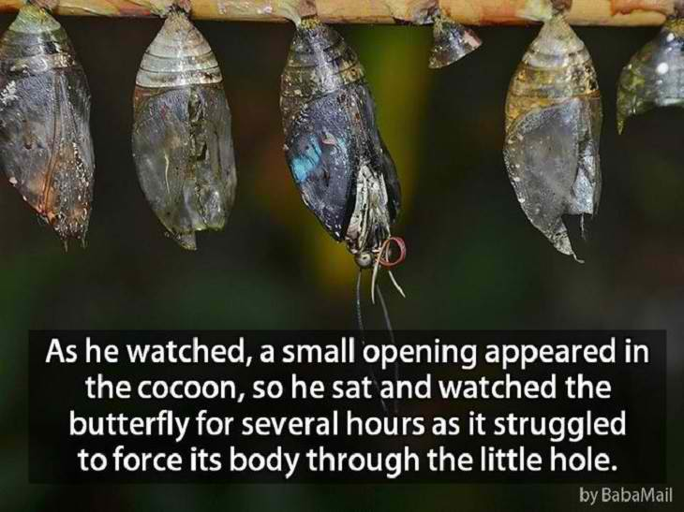

Slide 27
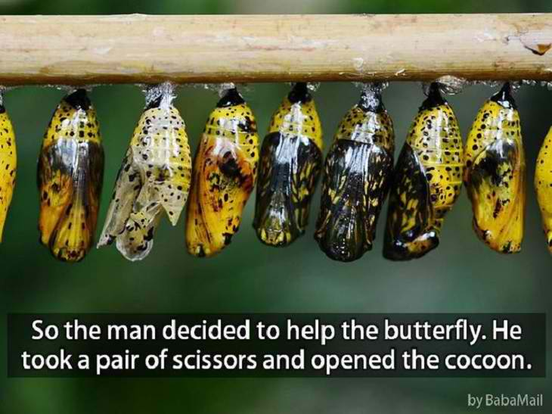

Slide 28
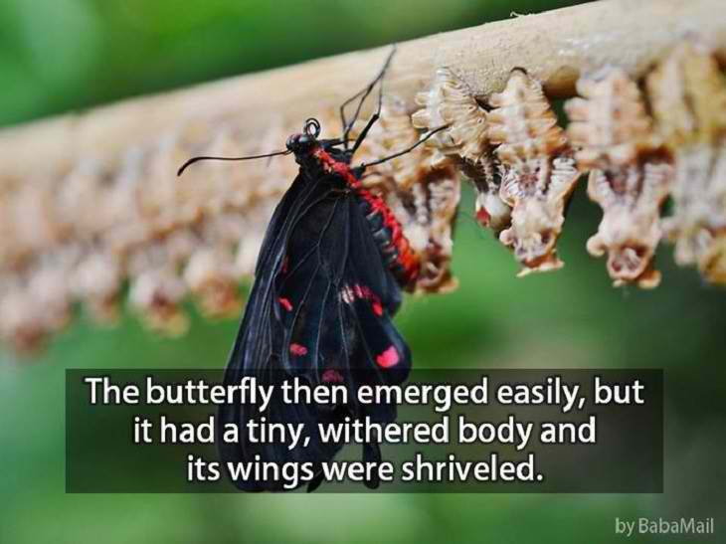

Slide 34
How do you see yourselves as leaders in your community?

