Slide 1







DEPED ZANORTE
SACEDA YOUTH LEAD
Empowering Leaders, Strengthening Communities
September 1-3, 2017

Slide 2
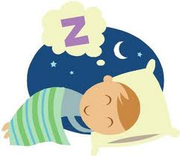
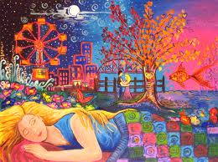
ACTIVITY 1
WHAT IS YOUR DREAM?

Slide 3
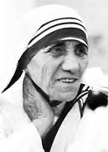
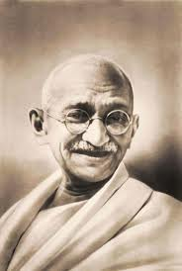
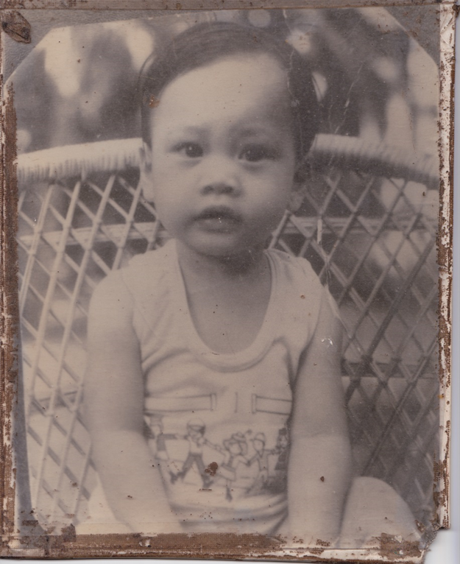
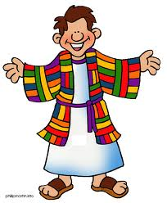
Living Examples of Dreamers
        Mother Teresa
        Mahatma Gandhi
        Jessica Sanchez
        Joseph the Dreamer
        Nadal
        Michael Jordan

Slide 4
Key Questions
Self
Family
Nation
(1) Choose a dream that you feel intensely about.
(2) What do you really want in your life?
(3) Why do you want this dream?
(4) Where is it coming from?

Slide 5
THE DREAMER GROWS UP…
SELF
FAMILY
NATION
Some dreams are meant to die…
Why?
*Because the dreamer has grown up…
*The dreams are not his or her dreams…
Distinguish whether it is a shallow dream or a soul dream…

Slide 6


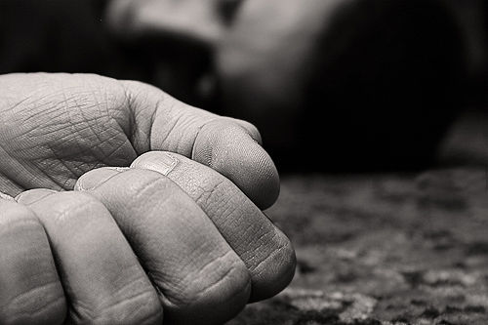

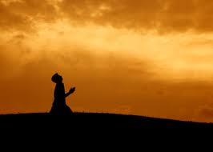
Let a Soul Dream be Born…
When does God reveal your soul dream?
When is your personal encounter?
What dreams in your heart that has never died?

Slide 7
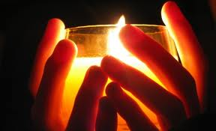
Signs of Soul Dreams for Leadership
The Dream Is Connected to Your Most Important Values
The Dream Must Bring You Closer to God

Slide 8
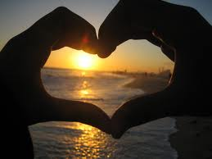
Signs of Soul Dreams for Leadership
The Dream Must Be Connected to Your Life Purpose and Core Gifts
The Dream Must Make You Happy in the Deepest Way Possible

Slide 9

Some of Your Dreams Are Too
Small—
Enlarge Them!
Or vice Versa!

Slide 10

EXAMINE YOUR ROOTS
What are you good at when you are still young?
What are you so passionate about?
Roots will lead to FRUITS…

Slide 11
THE REAL POWERS OF MAN (Career Branding)
INTELLIGENCE | SKILLS | VALUES
 |  | ------------------
 |  | -----------------
LINGUISTIC
Reading, Writing, Speaking, Listening,
Transliteration
Rhyming
Intonation
Foreign Language
Spelling, editing, emceeing, narrating, news-casting, Dj, declaiming, debate, discourse
SINCERITY
HUMILITY
RESPECT
FAITH.
HOPE
LOVE
Logic, math, analysis, accounting, engineering, plumbing, carpentry, decision making, financial literacy, calculated risk management
LOGIC / MATH
SPATIAL
Organization, direction, sequencing, driving
KINESTHETIC
All sports skills- Run Swim Walk, first aid, paramedics, body fit for life
MUSIC AND ARTS
Physical, Mental, Abstract, Culinary, Black
Playing of Musical Instruments, Singing, Dancing
INTERPERSONAL
Personal Grooming, Social Graces and Etiquette, Diplomacy and International Culture
INTRAPERSONAL
Essence of having a God
Faith and religiosity

Slide 12
INTELLIGENCE | SOFT SKILLS | HARD SKILLS | VALUES
LINGUISTIC | Reading, Writing, Speaking, Listening, DJ, Emceeing, Narrating, Newscasting, etc. |  | SINCERITY RESPECT HUMILITY
LOGIC/ MATH | Logic, math, analysis
SPATIAL | Organization, direction sequencing, driving,
KINESTHETIC | All sports skills | Mastery of Skills Creativity, Imagination
MUSIC/ARTS | Abstract, physical, mental, culinary, black Singing, dancing, playing of musical instruments
INTER-PERSONAL | Personal grooming, Social Graces, Etiquette
INTRA-PERSONAL | Essence of having a God
NEGOTIATION
CONFLICT RESOLUTION
MULTILINGUALISM
Translation/ Interpreting
LEADERSHIP
RESPONSE +
ABILITY
DECISION MAKING
PEACE
JOY
BALANCE
LOVE
Volunteerism
Resilience
Flexibility
Adaptability
FIRST AID/ PARAMEDICS
DISASTER PREPAREDNESS
DIPLOMACY, International Relations, PROTOCOLS
Honesty
Integrity
Deeper relationship with God
REAL POWERS OF MAN
Act 3

Slide 13
LEADERSHIP CONCEPTS
UNDERSTANDING VS. ACCEPTANCE
PROCEDURE VS. CONCEPTS
PROCESS ORIENTED VS. GOAL ORIENTED
ACHIEVEMENT- CONTRIBUTION-
P O S I T I V E
IMPACT

Slide 14

DRIVING NON TEACHING PERSONNEL’S PERFORMANCE
TEAM EFFECTIVENESS AND LEADERSHIP
2017

Slide 15
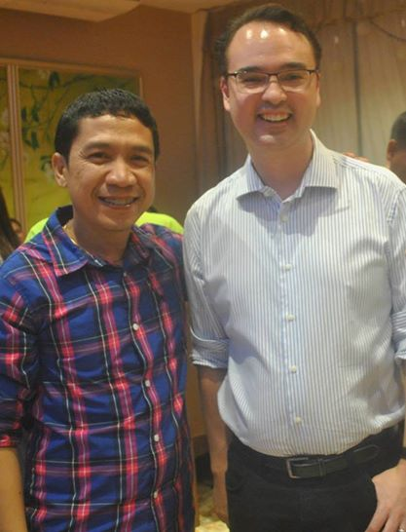
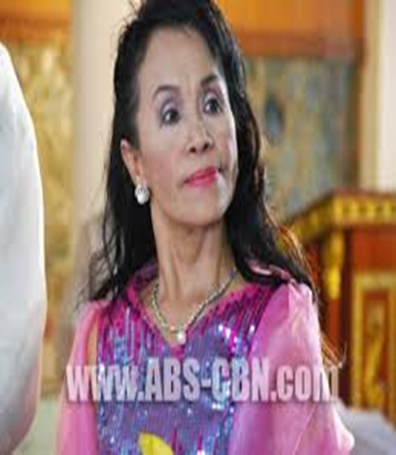
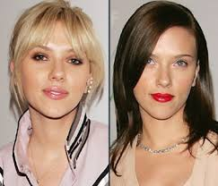
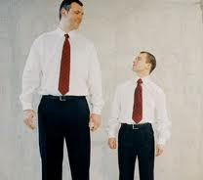
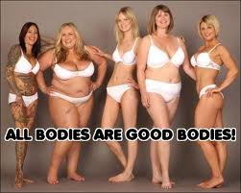
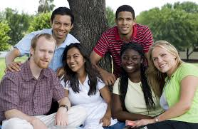
Who is more intelligent?
Who makes more money?

Slide 16
THE REAL POWERS OF MAN
INTELLIGENCE | SKILLS | VALUES
 |  | ------------------
 |  | -----------------
LINGUISTIC
Reading, Writing, Speaking, Listening,
Transliteration
Rhyming
Intonation
Foreign Language
Spelling, editing, emceeing, narrating, news-casting, Dj, declaiming, debate, discourse
SINCERITY
HUMILITY
RESPECT
FAITH.
HOPE
LOVE
Logic, math, analysis, accounting, engineering, plumbing, carpentry, decision making, financial literacy, calculated risk management
LOGIC / MATH
SPATIAL
Organization, direction, sequencing, driving
KINESTHETIC
All sports skills- Run Swim Walk, first aid, paramedics, body fit for life
MUSIC AND ARTS
Physical, Mental, Abstract, Culinary, Black
Playing of Musical Instruments, Singing, Dancing
INTERPERSONAL
Personal Grooming, Social Graces and Etiquette, Diplomacy and International Culture
INTRAPERSONAL
Essence of having a God
Faith and religiosity

Slide 17
INTELLIGENCE | SOFT SKILLS | HARD SKILLS | VALUES
LINGUISTIC | Reading, Writing, Speaking, Listening, DJ, Emceeing, Narrating, Newscasting, etc. |  | SINCERITY RESPECT HUMILITY
LOGIC/ MATH | Logic, math, analysis
SPATIAL | Organization, direction sequencing, driving,
KINESTHETIC | All sports skills | Mastery of Skills
MUSIC/ARTS | Abstract, physical, mental, culinary, black Singing, dancing, playing of musical instruments
INTER-PERSONAL | Personal grooming, Social Graces, Etiquette
INTRA-PERSONAL | Essence of having a God
NEGOTIATION
CONFLICT RESOLUTION
MULTILINGUALISM
LEADERSHIP
RESPONSE +
ABILITY
BALANCE
DECISION MAKING
Creativity/ Imaginative
PEACE
JOY
LOVE
Volunteerism
Resilience
Flexibility
Adaptability
FIRST AID/ PARAMEDICS
DISASTER PREPAREDNESS
DIPLOMACY, International Relations, PROTOCOLS
Honesty
Integrity
Deeper relationship with God
REAL POWERS OF MAN

Slide 18

2. EMOTIONAL QUOTIENT
Pikon
Katalon
Gahig Ulo
Alingasa
Mahadlokon
Sigurista
Kapayason
Tangaon
Luyahon
Super Abtik
Hilomon
Sensitibo
WHO IS MORE SUCCESSFUL?
Teachers of Public or Private Schools?

Slide 19
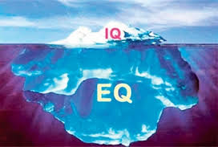
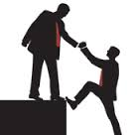
EMOTIONAL QUOTIENT
Parental LOVE
TRUST and SUPPORT
What happened?

Slide 20
LEADERSHIP CONCEPTS
UNDERSTANDING VS. ACCEPTANCE
PROCEDURE VS. CONCEPTS
PROCESS ORIENTED VS. GOAL ORIENTED
ACHIEVEMENT- CONTRIBUTION-
P O S I T I V E
IMPACT

Slide 21
LEADERSHIP CONCEPTS
ACHIEVEMENT
POSITIVE CONTRIBUTION
POSITIVE IMPACTS
SELF
FAMILY
COMMUNITY
NATION

Slide 22

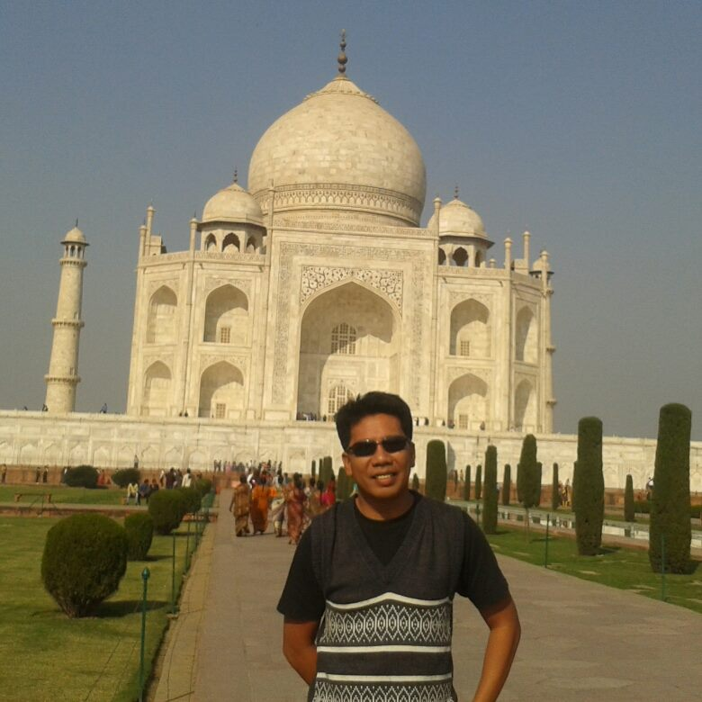
THINKING/ PLANNING
DRIVING LEADERS’ PERFORMANCE
Leadership that Produces Results
Thinking well is GOOD
Planning well is BETTER
BUT DOING WELL IS
THE BEST OF ALL

Slide 23
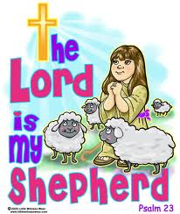
Desired Goals of the Training
Transparency in Governance
Assertiveness and Courage
Leadership by Example
Interdependence
Functional Self Discipline

Slide 24
PURPOSE
Transparency, Courage and
Assertiveness
Leadership by
Example
Interdependence
Self Discipline
The team lacks unity
of purpose or it has
two or more factions
moving in different
directions.
1234 Role of Restrictions and Law
National Anthem

Slide 25
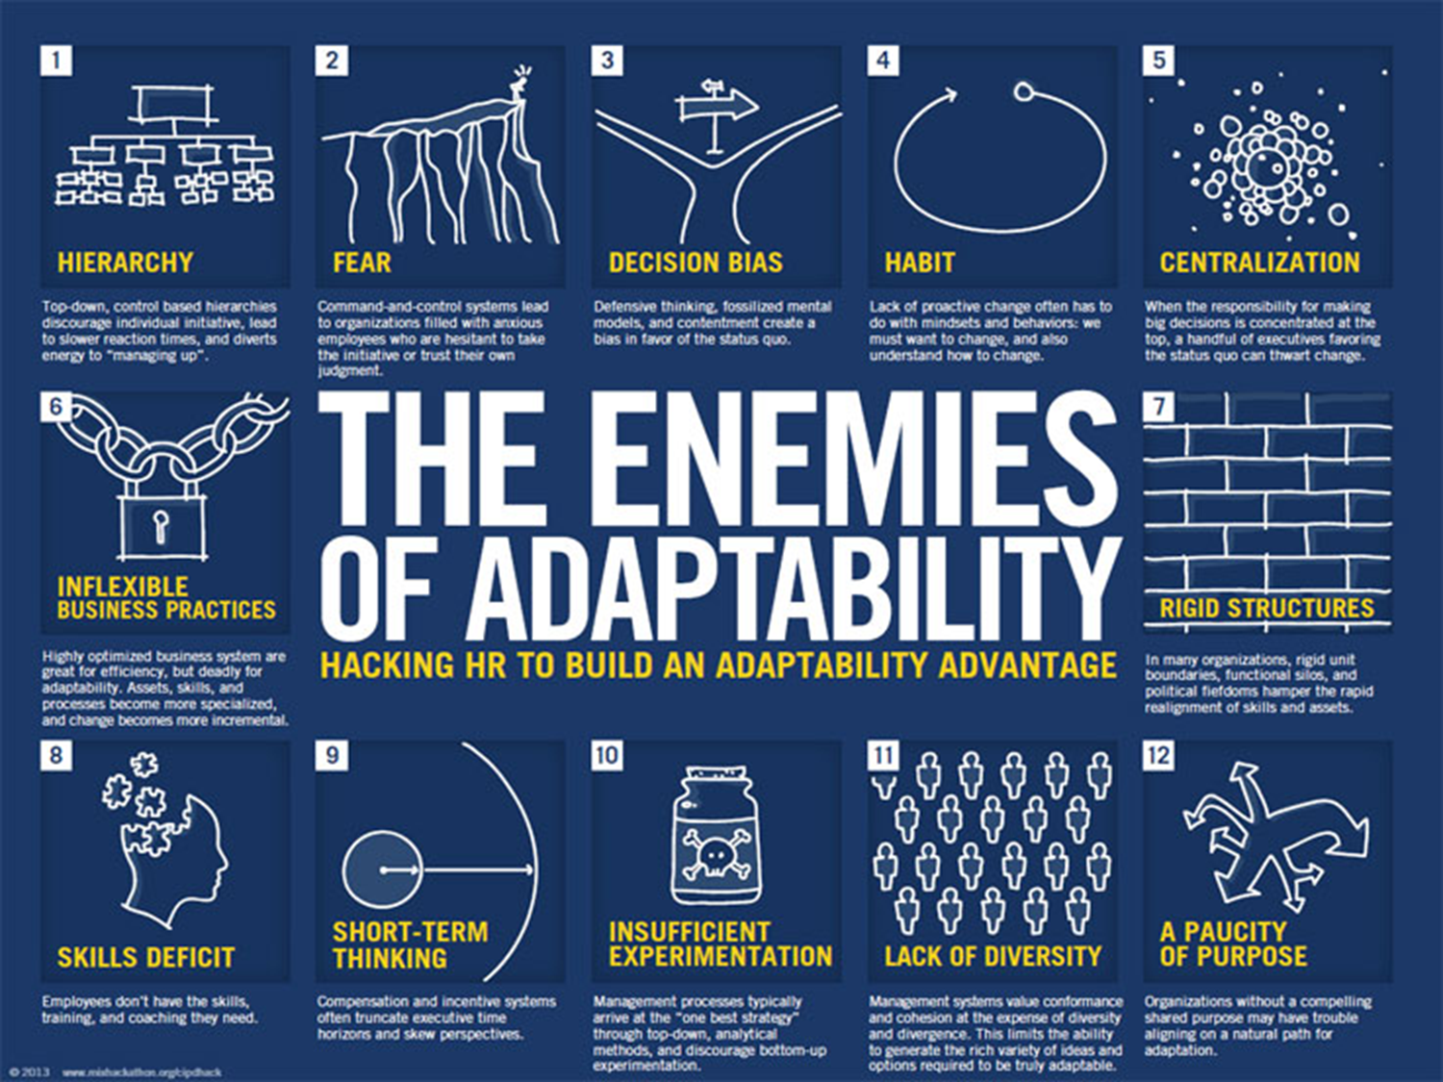
LEADERSHIP ROLES
HOW FLEXIBLE AND ADAPTABLE ARE YOU???
INDIVIDUAL ROLES
TEAM LEADERSHIP ROLES
SELF
FAMILY
COMMUNITY
NATION

Slide 26
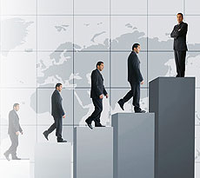
HOW DO WE PLAN OUR PLANS???
B
E
S
T
B
E
T
T
E
R
G
O
O
D

Slide 27

DECISION MAKING
NECESSARY
BENEFICIAL
PRACTICAL
OBEDIENCE
RIGHT vs. WRONG
HONESTY vs. DISHONESTY
HAPPINESS
VS.
MEANING
Team does not look at all
Angles when they decide,
It ends up in misery,
strained relationship and mistrust
Team decides for the
Greater advantage of all
Problem: Some members
dominate
decision making
to the exclusions of others
FOR THE GREATER
GLORY OF GOD;
FOR THE GOOD
OF ALL
LIFE or
DEATH
orangeapple

Slide 28
COMMUNICATION
To achieve genuine communication, you have to…LISTEN
SPACE OUT LISTENING
PRETEND LISTENING
WORD LISTENING
SELF CENTERED LISTENING
JUDGING

Slide 29
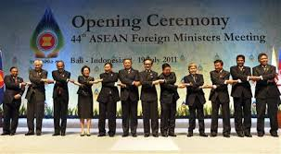
A starry starry night!

Slide 30
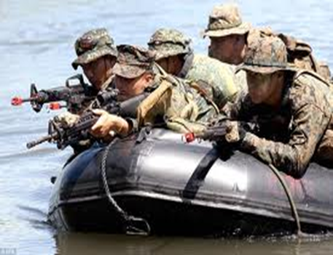
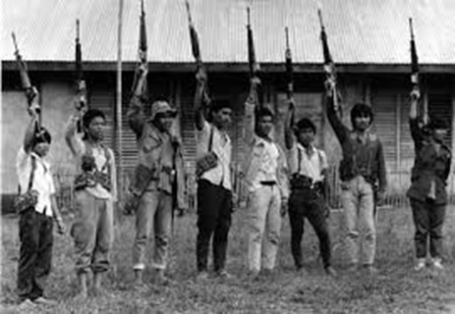
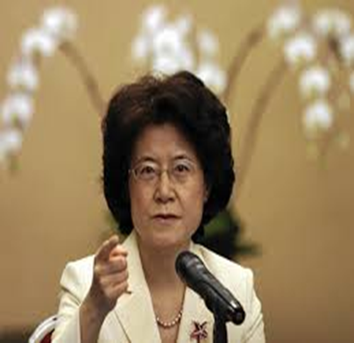
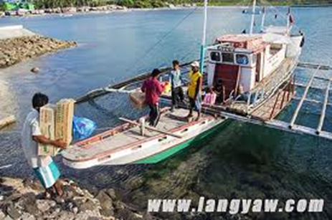
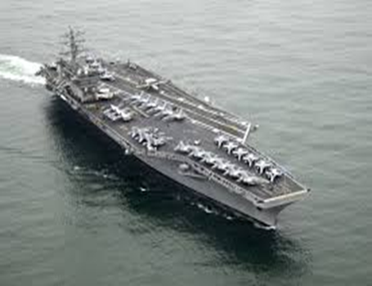
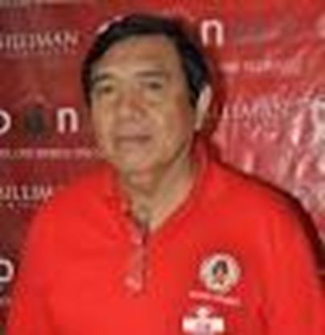
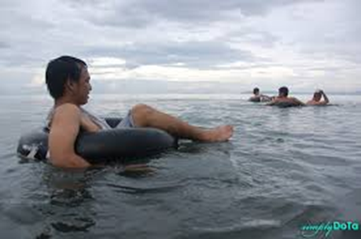
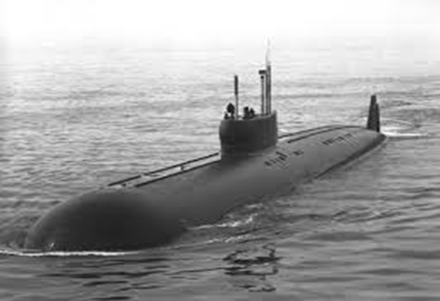

Slide 31
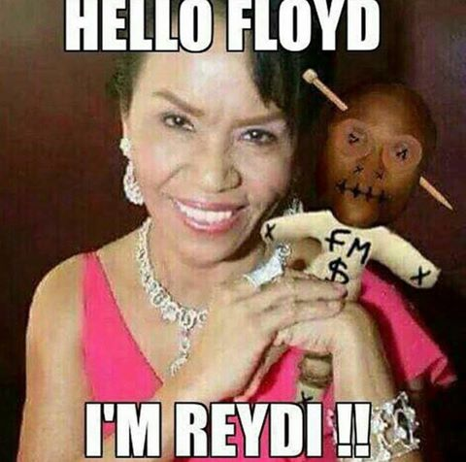

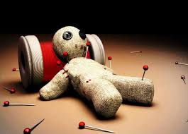
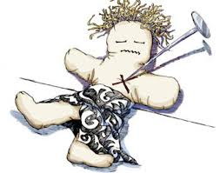
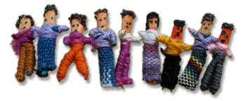
Starry Starry Night!

Slide 32

COMMUNICATION
Genuine Communication is…
7% WORDS
53% FEELINGS reflected on the voice
40% DYNAMICS like timing, pacing, articulation, diction, projection

Slide 33
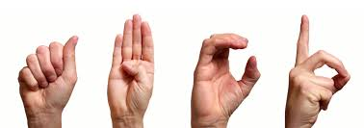
COMMUNICATION
Is not only verbal but as well as
NON VERBAL

Slide 34
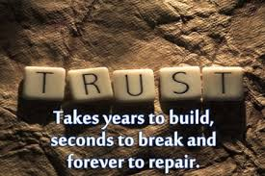
PL3: Leadership by Example
My bonnie lies over the ocean
My bonnie lies over the sea
My bonnie lies over the ocean
O bring back my bonnie to me
(Bring back (3x) my bonnie to me )2x

Slide 35

CONFLICT TRANSFORMATION

Slide 36




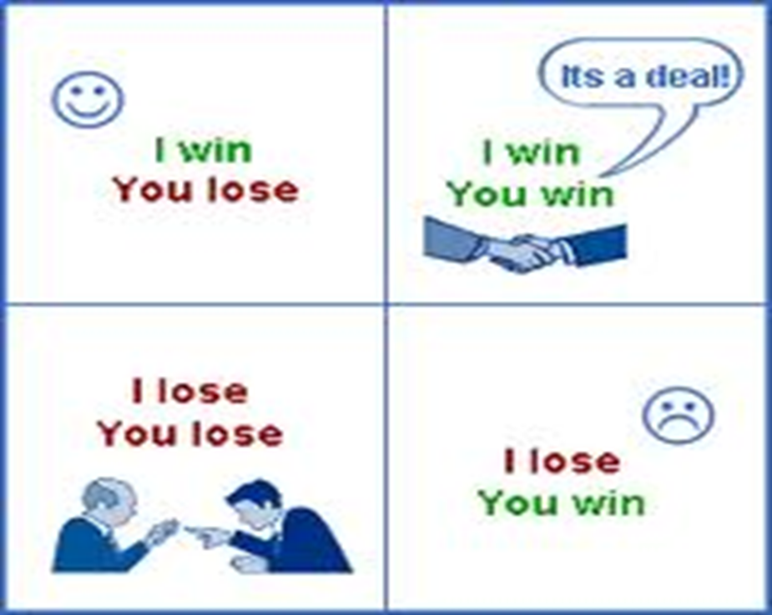
DECISION MAKING/ CONFLICT TRANSARFORMATION/
CONFLICT MANAGEMENT
Talk to God first before talking to the person
Always take the initiative
Sympathize with their feelings and confess your part of the problem
Attack the problem not the person
Cooperate as much as possible to achieve reconciliation
OBEDIENCE, RIGHT vs.WRONG
HONESTY v s.DISHONESTY
LIFE or DEATH
HAPPINESS vs. MEANING
NBP
FOR THE GREATER
GLORY OF GOD;
FOR THE GOOD
OF ALL
orangeapple

Slide 37

COOPERATION VS. COMPETITION
Cooperation means TRUST and LOVE…and the best expression to manifest our love is on how much TIME we are willing to invest in our team.
Cooperation means there is no I or me in a team, it is all the time WE and US.
Cooperation is how much we give of OURSELVES
Cooperation is loving and giving

Slide 38


9. COLLABORATE
Collaboration is a working practice whereby individuals work together to a common purpose to achieve business benefit

Slide 39
TEAM FIGHTING SPIRIT
With different Powers
People do come Together
As One Unified Team with a
Spirit that Fights till the End

Slide 40
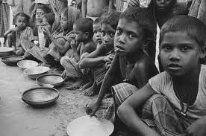
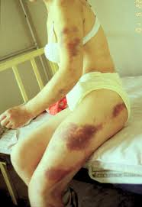
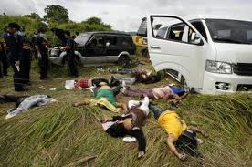
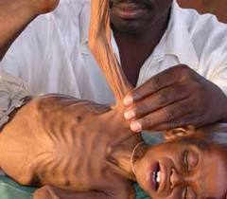
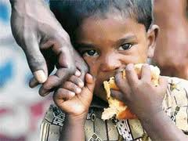
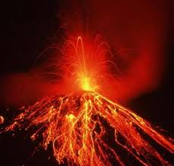
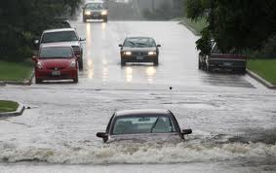
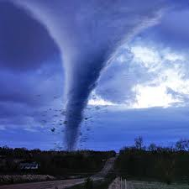
Why Am I Called to Be a Leader?
Self
Family
Community/
Nation

Slide 41
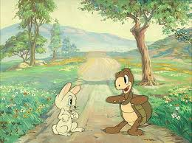
RABBIT AND THE TURTLE

Slide 42
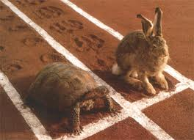
A Race is Planned…

Slide 43
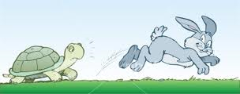
The rabbit ran as fast as he can…

Slide 44
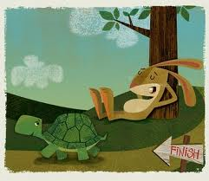
The rabbit was too arrogant…he slept and rest…

Slide 45

And so, the Turtle won…

Slide 46
Rabbit realized his mistake…

Slide 47
Go Rabbit Go!

Slide 48

He ran as fast as he can…rabbit won!

Slide 49

Turtle made another plan…

Slide 50

Both ran as fast as they can…

Slide 51

With water course we must pursue…

Slide 52

The turtle won again…

Slide 53
They both realized a big lesson…

Slide 54


Knowing Your Strengths and Weaknesses

Slide 55
And both won the race and learned a big lesson about teamwork

Slide 56
TEAMWORK WORKS…
SELF
FAMILY
NATION
“Resolve Inequity”
We Need People with POSITIVE ATTITUDES not people with
NEGATIVE ATTITUDES in the system!

Slide 57

TEAM FIGHTING SPIRIT

Slide 58

THANK YOU VERY MUCH
SACEDA YOUTH LEAD
SYL Center, Puork Likod
Brgy . Candau-ay6200 Dumaguete City
The Philippines
Mobile: 0915 633 9546
Email: sacedayouthlead@gmail.com
Syl.school@yahoo.com
www.sacedayouthlead.org
Blog: Sacedayouthlead.blogspot.com

Slide 59
TEAM WORK 1: QUIZ BOWL

Slide 60
TEAM WORK 2
Top 5 Performing Teams vs. Others
Music and Arts

Slide 61
TEAM WORK 3
IRON MEN AND WOMEN

Slide 62
TEAM WORK 4
COUNT OF MONTE CRISTO

Slide 63

TEAM WORK 5
DRAW A REPLICA WITH YOUR MOUTH

Slide 64
TEAM WORK 6 BASIN

Slide 65
TEAM WORK 7 THE WEB

Slide 66
TEAM WORK 8 CATCH THE FLAG

Slide 67
TEAM WORK 9
CHINESE GARTER

Slide 68
Team Work 10 Animal Sound Off
Aw aw dog, aw aw dog,
Aw aw dog to…
Meow meow cat, meow meow cat,
Meow meow cat to….
Tweet tweet bird, tweet tweet bird,
Tweet tweet bird to…
Quack quack duck, quack quack duck,
Quack quack duck to…
Oink oink pig, oink oink pig
Oink oink pig to..
Moo moo cow, moo moo cow
Moo moo cow to…

